Slide 1

Mental Health Waiver
Provider Meeting
July 30, 2024

Slide 2
Agenda
Waiver Update
Average Enrolled by Month
HCBS Conference presentation
RA Training Process
RA Post-Education Trainings
988 Magnets
Use of secure email
Re-Credentialing Requirements
Gainwell Re-credentialing
Monthly notes
Monthly RA note quality
EVV Compliance rates
MHW Advisory Council

Slide 3
Waiver Update (as of 7/22/2024)
Active participants on the waiver: 583
Actively planning for admission to waiver (MHW & MFP): 46
Referrals pending disposition (MHW & MFP): 55
Waitlisted referrals for MHW community: 10
Community Census for Waiver Year 15: 615
Additional Slots for MFP participants Waiver Year 15: 45
If you are making a referral to the MHW please remember to send in any psychosocial and functional assessments to assist with eligibility determination.

Slide 5
HCBS Conference presentation
DMHAS has submitted a presentation proposal to the 2024 HCBS Conference which will be held in Baltimore in August.
The DMHAS presentation will focus on changes in the RA position throughout the 15 years of the MHW, including lessons learned and training revisions.
https://www.advancingstates.org/hcbsconference

Slide 6
RA Training process
ABH and DMHAS are currently working on a “on-demand” RA training option. We are hopeful this will be completed sometime in the fall.

Slide 7

RA Post Education Trainings
  Please remember that RA staff should be receiving some type of boundaries training within 6 months of employment. RAs are still required to have 6 hours of additional training per year. We will continue to send out information regarding trainings available through ABH, DMHAS and the community.
  The following trainings are on the ABH website for staff to review (under the CSP section):
    Fall Prevention Training
    Diabetes 101 Training
    Medicaid Requirements for MHW application and renewals

Slide 8



988 Magnets for clients
Please consider ordering some of these free magnets for direct care staff to place in client apartments.
https://www.samhsa.gov/resource-search/988?rc%5B0%5D=resource_type%3A21298&page=0

Slide 9

Use of secure email
Please remind staff that if personal client information is needed to be included in an email, that the email should be sent securely.
Personal information includes: name, date of birth, social security number, Medicaid number.
Remember to check the subject line-no PHI should appear there.
WOS ID numbers are not identifiable and can be used safely in email communication if needed.

Slide 10

Re-credentialing requirements
Re-credentialing of all services is now required every 2 years.
CSP
  Supervisor: Master’s level or licensed
  Agency accreditation: CARF, TJC, COA, etc
  Staff: Bachelor’s degree in related field or 2 years work experience. Now requires CBC every 2 years
RA
  Supervisor: Master’s level or licensed
  Staff: initial training, 6 hours yearly training, CBC every 2 years
Peer Support
  Supervisor: Master’s level or licensed
  Agency: CARF, TJC, COA etc.
  Staff: RSS certification through Advocacy Unlimited or CCAR

Slide 11
Gainwell Re-credentialing
MHW Provider agencies must re-credential with Gainwell every 2 years. This is separate from the ABH re-credentialing process
If you credentialing with Gainwell lapses, your agency will not be able to receive new authorizations or bill until you are re-credentialed with Gainwell.
Gainwell will require you submit a letter from ABH confirming that you are currently credentialed with ABH. Please reach out to Thelma Boisseau or Ann Marie Luongo to obtain this letter.

Slide 12
Monthly Progress Notes
Please remember that your agency will be required to submit a note for any authorization that is active for at least one day during the month. Please check to make sure that clinicians close out interventions when you stop providing service. If you are not getting a timely response, please reach out to Ann Marie Luongo or Jenny DeMars at ABH.
Reminder the only note now due for CSP is the Monthly Summary.
Failure to complete timely notes may lead to agency being placed on hold for new referrals.

Slide 13
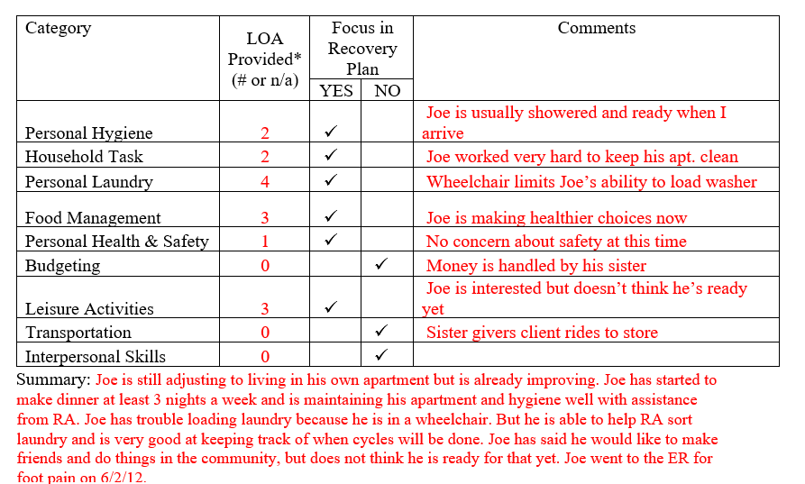
Monthly RA note quality
Please remember to provide as much information as possible to the RA monthly note. Paper RA encounter notes were discontinued with the understanding that monthly notes would sufficiently replace them.

Slide 14
EVV Compliance Rates
Direct Care staff should be signing in and out either on a mobile app or the client’s home phone. If any client has an issue with the use of their phone, please contact their clinician immediately.
EVV Compliance rate requirement: 75%
ABH will run reports on EVV compliance rates and include them on Quarterly Report Cards. Agencies who do not continue to meet compliance rates will be placed on hold from receiving new referrals.

Slide 15

MHW Advisory Council
Meets twice a year in April and October
Open to any MHW provider to send a representative
Meetings will now be held both in person and virtual. If you are interested in attending virtually, please contact Katie Daly for the link. (Katie.daly@ct.gov)
We encourage staff to identify MHW participants who might be interested in participating. Staff can bill for time spent with participant at meeting.

Slide 16
Authorizations/Billing Issues
If an authorization is missing in either the ABH portal or Gainwell system, please reach out to ABH for assistance.
  Emilie LeBlanc: eleblanc@abhct.com 860-704-6123
  Jenny DeMars: jdemars@abhct.com 860-704-6254
If an authorization is missing in Sandata, please contact Sandata and Gainwell for assistance. (Reminder that auths can take 24-48 hours to reach Sandata)
  Sandata: ctcustomercare@sandata.com 855-399-8050
  Gainwell: ctevv@gainwelltechnologies.com
  For billing issues, ABH can no longer see your claims. Please contact Gainwell first to obtain information on why your claim was denied.

Slide 17
ABH Contact Information
Ann Marie Luongo, Program Manager (general waiver info, clinician info/issues, adding staff to ABH portal)
  (860) 704-6211 aluongo@abhct.com
Jenny DeMars, Quality Assurance Supervisor (client eligibility, report cards, audits, notes)
  (860) 704-6254 jdemars@abhct.com
Thelma Boisseau, Program Specialist (credentialing questions, RA trainings)
  (860) 638-5341 tboisseau@abht.com
Emilie LeBlanc, Claims Coordinator (authorization and claims issues, report cards, client eligibility)
  860-704-6123 eleblanc@abhct.com
Laura Biggs, Utilization Review Support (critical incident reports, client surveys, provider surveys, report cards)
  (860) 704-6182 lbiggs@abhct.com
    FAX NUMBER 860-920-4456

