Slide 1

Mental Health Waiver
Provider Meeting
January 28, 2025

Slide 2
Agenda
Waiver Update
Average Enrolled by Month
Staffing Updates
RA Training Process
Use of secure email/new ABH secure email
Transportation
Communication between CSP & RA
Knowledge of Recovery Plan
Updated Peer Support credentialing requirements
UCONN survey
Monthly notes: focus on objectives
Monthly RA note quality
MHW Advisory Council

Slide 3
Waiver Update (as of 1/27/2025)
Active participants on the waiver: 579
Actively planning for admission to waiver (MHW & MFP): 36
Referrals pending disposition (MHW & MFP): 71
Waitlisted referrals for MHW community: 4
Community Census for Waiver Year 15: 615
Additional Slots for MFP participants Waiver Year 15: 45
If you are making a referral to the MHW please remember to send in any psychosocial and functional assessments to assist with eligibility determination.

Slide 5
Staffing Updates
Shay started with ABH as a CSC on November 4th and has taken over the caseload previously covered by Nicole Kavalan (New Haven area)
Stacy Dingee started with ABH as a CSC on November 25th and has taken over the caseload previously covered by Amanda Smith (Northeast and Manchester area)
Sheanelle Dougall started with ABH as a CSC on December 17th and will be taking over the caseload currently covered by Kristin Belmonte (Bridgeport). Kristin will be starting to cover the Northwest corner and the caseload previously covered by Amanda Clavette.

Slide 6
RA Training process
The On Demand RA training is now live ☺
New RA staff can now access the training at their own convenience and either complete at one time or over multiple sessions.
Agencies simply need to provide ABH with the name and email address of prospective MHW RA staff.
This training is for potential MHW RA staff only. Please do not access or request access for staff working on other waivers/programs.

Slide 7

Use of secure email
Please remind staff that if personal client information is needed to be included in an email, that the email should be sent securely.
Personal information includes: name, date of birth, social security number, Medicaid number.
Remember to check the subject line-no PHI should appear there.
WOS ID numbers are not identifiable and can be used safely in email communication if needed.

Slide 8
Transportation
MHW staff continue to remind clients that transportation is not a covered part of the program and they should be working on learning about and utilizing resources in the community.
It is up to each provider agency to decide their policy on transporting clients, however, please make sure we are not encouraging clients to become dependent on these services. We cannot maintain an individual on the MHW simply to provide transportation.
Please make sure to address transportation issues at the 6 month reviews.

Slide 9
Communication between CSP & RA
CSP and RA staff are allowed to overlap their time for up to 30 minutes each week as needed.
It is important that CSP and RA staff are in regular communication to coordinate services for their client.
CSP and RA can overlap for longer at review meetings and in other similar situations.
If you have any questions about overlap of services or are having difficulty with communication between CSP and RA staff, please address at 6 month reviews or bring it to the attention of the clinician.

Slide 10
Knowledge of Recovery Plan
CSP and RA staff should be planning their time with clients around what is contained in the Recovery plan.
Please make sure staff are reviewing the plan so they are aware of how they should be spending their time.
No CSP or RA should be stating that they have no idea what is on their client’s plan.
Tasks and notes need to reflect what is on the client’s plan.

Slide 11
Peer Support updates regarding credentialing
DMHAS is updating the requirements for Peer Support Services and staff will be certified through the Connecticut Certification Board (CCB)
New PS certifications will only be provided to individuals with lived experience
Current Peer Support staff will have an opportunity to be grandfathered in beginning in May 2025
  Application and exam will be available through CCB
  Staff must have 10 hours of CEUs documented to qualify
  There will be no cost for grandfathering

Slide 12
UCONN Survey
UCONN will be conducting a survey to look at gaps that were found in some of our client outcomes by gender, race and ethnicity.
Provider agencies will be receiving a Survey Monkey link. Please take a few moments to provide your feedback and assist in this research.

Slide 13
Monthly Progress Notes
Please remember that your agency will be required to submit a note for any authorization that is active for at least one day during the month. Please check to make sure that clinicians close out interventions when you stop providing service. If you are not getting a timely response, please reach out to Ann Marie Luongo or Jenny DeMars at ABH.
Reminder the only note now due for CSP is the Monthly Summary.
Failure to complete timely notes may lead to agency being placed on hold for new referrals.

Slide 14
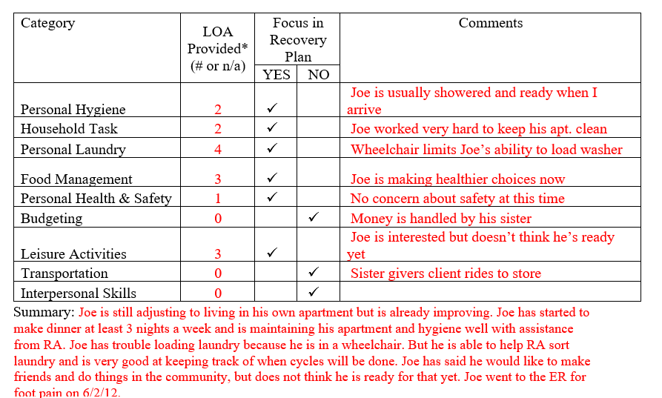
Monthly RA note quality
Please remember to provide as much information as possible to the RA monthly note. Paper RA encounter notes were discontinued with the understanding that monthly notes would sufficiently replace them.

Slide 15

MHW Advisory Council
Meets twice a year in April and October
Open to any MHW provider to send a representative
Meetings will now be held both in person and virtual. If you are interested in attending virtually, please contact Katie Daly for the link. (Katie.daly@ct.gov)
We encourage staff to identify MHW participants who might be interested in participating. Staff can bill for time spent with participant at meeting.

Slide 16
ABH Contact Information
Ann Marie Luongo, Program Manager (general waiver info, clinician info/issues, adding staff to ABH portal)
  (860) 704-6211 aluongo@abhct.com
Jenny DeMars, Quality Assurance Supervisor (client eligibility, report cards, audits, notes)
  (860) 704-6254 jdemars@abhct.com
Thelma Boisseau, Program Specialist (credentialing questions, RA trainings)
  (860) 638-5341 tboisseau@abht.com
Emilie LeBlanc, Claims Coordinator (authorization and claims issues, report cards, client eligibility)
  860-704-6123 eleblanc@abhct.com
Laura Biggs, Utilization Review Support (critical incident reports, client surveys, provider surveys, report cards)
  (860) 704-6182 lbiggs@abhct.com
    FAX NUMBER 860-920-4456

