Slide 1

Mental Health Waiver
Provider Meeting
April 23, 2024

Slide 2
Agenda
Waiver Update
Average Enrolled by Month
MHW Provider Fair
HCBS Conference presentation
RA Training Process
RA Post-Education Trainings
Providing recovery plans to staff/having in client homes
988 Magnets
Use of secure email
Re-Credentialing Requirements
Monthly notes
Authorizations/Billing Issues
EVV Compliance rates and EVV choice
MHW Advisory Council

Slide 3
Waiver Update (as of 4/22/2024)
Active participants on the waiver: 570
Actively planning for admission to waiver (MHW & MFP): 51
Referrals pending disposition (MHW & MFP): 59
Waitlisted referrals for MHW community: 23
Community Census for Waiver Year 15: 615
Additional Slots for MFP participants Waiver Year 15: 45
If you are making a referral to the MHW please remember to send in any psychosocial and functional assessments to assist with eligibility determination.

Slide 5
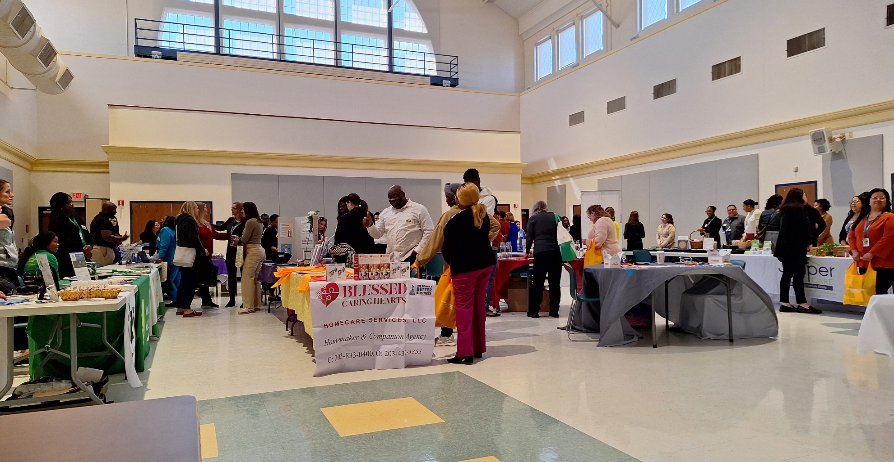
MHW Provider Fair April 22, 2024
Thank you to all who attended!

Slide 6
HCBS Conference presentation
DMHAS has submitted a presentation proposal to the 2024 HCBS Conference which will be held in Baltimore in August.
The DMHAS presentation will focus on changes in the RA position throughout the 15 years of the MHW, including lessons learned and training revisions.
If your agency has a client and RA pairing that would like to speak about their experience working together and would not mind being taped, please reach out to Katie Daly. Katie.daly@ct.gov 860-262-6956
https://www.advancingstates.org/hcbsconference

Slide 7

RA Training process
ABH and DMHAS are currently working on a “on-demand” RA training option. Simulation videos are in the editing stage and we hope to record the presentations soon. More info to come!
In the interim, please continue to register applicants for ABH provided trainings. If you provide your own RA trainings and have not received an updated testing link effective 1/1/2024, please reach out to Ann Marie

Slide 8

RA Post Education Trainings
  Please remember that RA staff should be receiving some type of boundaries training within 6 months of employment. RAs are still required to have 6 hours of additional training per year. We will continue to send out information regarding trainings available through ABH, DMHAS and the community.
  The following trainings are on the ABH website for staff to review (under the CSP section):
    Fall Prevention Training
    Diabetes 101 Training
    Medicaid Requirements for MHW application and renewals

Slide 9
Access to Recovery Plans
Clients and direct care staff need to have access to the Recovery Plan while working.
Please make sure that there is a copy of the Recovery Plan in the client’s home.
If there is not a copy there, please either provide on to direct care staff to place in the home.
If you are concerned about staff hand carrying confidential information, please consider mailing a plan to client or requesting that MHW clinician send a copy to the client.

Slide 10



988 Magnets for clients
Please consider ordering some of these free magnets for direct care staff to place in client apartments.
https://www.samhsa.gov/resource-search/988?rc%5B0%5D=resource_type%3A21298&page=0

Slide 11

Use of secure email
Please remind staff that if personal client information is needed to be included in an email, that the email should be sent securely.
Personal information includes: name, date of birth, social security number, Medicaid number.
Remember to check the subject line-no PHI should appear there.
WOS ID numbers are not identifiable and can be used safely in email communication if needed.

Slide 12

Re-credentialing requirements
Re-credentialing of all services is now required every 2 years.
CSP
  Supervisor: Master’s level or licensed
  Agency accreditation: CARF, TJC, COA, etc
  Staff: Bachelor’s degree in related field or 2 years work experience. Now requires CBC every 2 years
RA
  Supervisor: Master’s level or licensed
  Staff: initial training, 6 hours yearly training, CBC every 2 years
Peer Support
  Supervisor: Master’s level or licensed
  Agency: CARF, TJC, COA etc.
  Staff: RSS certification through Advocacy Unlimited or CCAR

Slide 13
Monthly Progress Notes
Please remember that your agency will be required to submit a note for any authorization that is active for at least one day during the month. Please check to make sure that clinicians close out interventions when you stop providing service. If you are not getting a timely response, please reach out to Ann Marie Luongo or Jenny DeMars at ABH.
Reminder the only note now due for CSP is the Monthly Summary.
Failure to complete timely notes may lead to agency being placed on hold for new referrals.

Slide 14
Authorizations/Billing Issues
If an authorization is missing in either the ABH portal or Gainwell system, please reach out to ABH for assistance.
  Emilie LeBlanc: eleblanc@abhct.com 860-704-6123
  Jenny DeMars: jdemars@abhct.com 860-704-6254
If an authorization is missing in Sandata, please contact Sandata and Gainwell for assistance. (Reminder that auths can take 24-48 hours to reach Sandata)
  Sandata: ctcustomercare@sandata.com 855-399-8050
  Gainwell: ctevv@gainwelltechnologies.com
  For billing issues, ABH can no longer see your claims. Please contact Gainwell first to obtain information on why your claim was denied.

Slide 15
EVV Compliance Rates and EVV Choice
Direct Care staff should be signing in and out either on a mobile app or the client’s home phone. If any client has an issue with the use of their phone, please contact their clinician immediately.
EVV Compliance rate requirement: 75%
ABH will run reports on EVV compliance rates and include them on Quarterly Report Cards. Agencies who do not continue to meet compliance rates will be placed on hold from receiving new referrals.
The last Town Hall session for Alternate EVV will be held April 30th at 10am. The form to register your decision to utilize an Alternate EVV provider will be made available shortly after testing of the system has been completed. Please notify Ann Marie if your agency has decided to utilize an Alternate EVV provider so that we can access your data in the alternate system.
The use of an Alternate EVV provider is not required. Your agency may still continue to use Sandata at no additional expense. If you choose to use an Alternate EVV provider, DSS will not cover any expenses.

Slide 16

MHW Advisory Council
Meets twice a year in April and October
Open to any MHW provider to send a representative
Meetings will now be held both in person and virtual. If you are interested in attending virtually, please contact Katie Daly for the link. (Katie.daly@ct.gov)
We encourage staff to identify MHW participants who might be interested in participating. Staff can bill for time spent with participant at meeting.

Slide 17
ABH Contact Information
Ann Marie Luongo, Program Manager (general waiver info, clinician info/issues, adding staff to ABH portal)
  (860) 704-6211 aluongo@abhct.com
Jenny DeMars, Quality Assurance Supervisor (client eligibility, report cards, audits, notes)
  (860) 704-6254 jdemars@abhct.com
Thelma Boisseau, Program Specialist (credentialing questions, RA trainings)
  (860) 638-5341 tboisseau@abht.com
Emilie LeBlanc, Claims Coordinator (authorization and claims issues, report cards, client eligibility)
  860-704-6123 eleblanc@abhct.com
Laura Biggs, Utilization Review Support (critical incident reports, client surveys, provider surveys, report cards)
  (860) 704-6182 lbiggs@abhct.com
    FAX NUMBER 860-920-4456

