Slide 1

Mental Health Waiver
Provider Meeting
October 28, 2025

Slide 2
Agenda
Waiver Update
Average Enrolled by Month
Staffing Updates
RA Training Process
CSP Initial Training
Access to ABH website
Cultural Competency Training resource page
Food stamps
Update on Peer Support credentialing requirements
Monthly RA note quality
Monthly CSP note quality/Training
MHW Advisory Council

Slide 3
Waiver Update (as of 10/20/2025)
Active participants on the waiver: 562
Actively planning for admission to waiver (MHW & MFP): 47
Referrals pending disposition (MHW & MFP): 35
Waitlisted referrals for MHW community: 8
Community Census for Waiver Year 17: 615
Additional Slots for MFP participants Waiver Year 17: 45
If you are making a referral to the MHW please remember to send in any psychosocial and functional assessments to assist with eligibility determination.

Slide 5
Staffing Updates
The Quality Assistant position at ABH has been filled by Jenna Bazelais.
ABH is currently interviewing candidates for the MFP program clinician.
Thelma Boisseau has taken another position at ABH and we are currently recruiting for the Program Specialist position.
DMHAS has hired Deanna Bencivengo for the Housing Coordinator position.
Erin Leavitt-Smith will be retiring from DMHAS in February 2026.
Jenny Demars will be retiring in May 2026 and ABH is currently working on a transitional plan.

Slide 6
RA Training process
The On Demand RA training is now live ☺
Please remember that if you have not received confirmation from ABH that staff has completed all training, that they have not been placed on the registry.
We have a number of staff who partially complete training. When you are signing up staff, please encourage them to complete the training in full as soon as possible.
Please try and sign up staff who you feel confident will follow through with training. We currently are seeing a 50% completion rate for RA training.

Slide 7
CSP training
The recording of the new CSP training is live on the ABH website. Please remember to have all new CSP staff review before they start with clients.
https://www.youtube.com/watch?v=TTkQqQNv_HA
Please remember to verify that all new CSP staff meet the requirements before they start work:
  Bachelor’s degree in a social services field or at least 2 years experience working with the mental health population.
  Please make sure resumes verify this information and are available during re-credentialing.

Slide 8
Access to ABH website
CSP and administrative staff that need access to the ABH website for notes, recovery plans, etc. should be logging into the site at least every month.
Please only request access for staff that will need to use the site on a regular basis as ABH is required to pay a fee per user.
Users who do not sign in on a regular basis will have their accounts deactivated.
Please inform us when staff who have access leave your agency so we may deactivate their accounts immediately.

Slide 9
Cultural Competency Resource Training page
ABH will be adding a Cultural Competency Resource page to the Mental Health Waiver section of their website soon. We will be adding information for CSP and RA staff to access.
Please feel free to send in any resources you would like to share with other provider agencies and we will add to our page.

Slide 10
Food Stamps
If clients are unable to receive food stamps November 1st they can access Home Delivered Meals through their waiver plan if they don’t currently have them.
Client’s can receive up to 2 meals daily.
If you have a client who is in need please reach out to their waiver clinician.

Slide 11
Peer Support updates regarding credentialing
DMHAS is updating the requirements for Peer Support Services and staff will be certified through the Connecticut Certification Board (CCB).
Anyone who completes a DMHAS-approved training on or before February 1, 2026 is eligible. Must submit application by October 1, 2026.
To apply: Grandparenting application on CCB website https://yalesurvey.ca1.qualtrics.com/jfe/form/SV_e8lz9kDCi4bBOGa
Required Documents: State or Federal Picture ID and Training Completion Certificate
No Test!!! No CEUs needed!!!

Slide 12
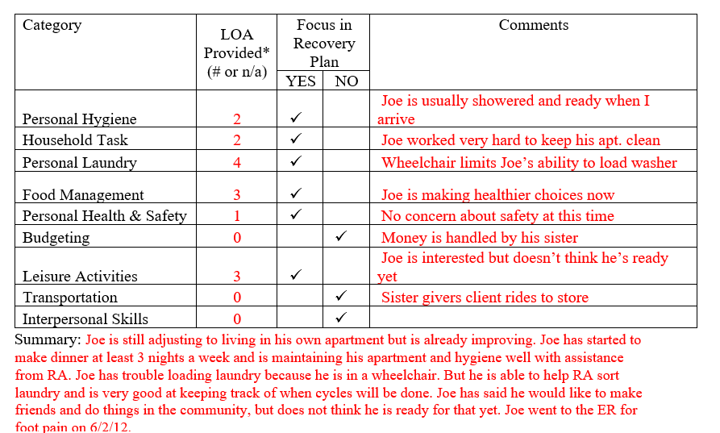
Monthly RA note quality
Please remember to provide as much information as possible to the RA monthly note. Paper RA encounter notes were discontinued with the understanding that monthly notes would sufficiently replace them.

Slide 13
Monthly CSP note quality
When writing the monthly CSP note, staff should be responding to client progress with objectives as listed in the recovery plan.
We will be developing a training for CSP monthly notes that will be recorded and used as an ongoing training tool.

Slide 14

MHW Advisory Council
Meets twice a year in April and October
Open to any MHW provider to send a representative
Meetings will now be held both in person and virtual. If you are interested in attending virtually, please contact Katie Daly for the link. (Katie.daly@ct.gov)
We encourage staff to identify MHW participants who might be interested in participating. Staff can bill for time spent with participant at meeting.

Slide 15
ABH Contact Information
Ann Marie Luongo, Program Manager (general waiver info, clinician info/issues, adding staff to ABH portal)
  (860) 704-6211 aluongo@abhct.com
Jenny DeMars, Quality Assurance Supervisor (client eligibility, report cards, audits, notes)
  (860) 704-6254 jdemars@abhct.com
Vacant, Program Specialist (credentialing questions, RA trainings)
  (860) 638-5341
Emilie LeBlanc, Claims and Quality Analyst (authorization and claims issues, report cards, client eligibility)
  860-704-6123 eleblanc@abhct.com
Jenna Bazelais, Quality Assurance Assistant (critical incident reports, client surveys, provider surveys, report cards)
  (860) 704-6121 jbazelais@abhct.com
    FAX NUMBER 860-920-4456

