Slide 1

Mental Health Waiver
Provider Meeting
July 21, 2026

Slide 2
Agenda
Waiver Update
Average Enrolled by Month
Staffing Updates
Waiver renewal
RA Training Process
Provider requirements: Monthly notes
Access to ABH website
Update on Peer Support credentialing requirements
Critical Incident Reports
Documenting manually entered visits in EVV
MHW Advisory Council

Slide 3
Waiver Update (as of 6/20/2026)
Active participants on the waiver: 516
Actively planning for admission to waiver (MHW & MFP): 39
Referrals pending disposition (MHW & MFP): 49
Waitlisted referrals for MHW community: 10
Community Census for Waiver Year 17: 615
Additional Slots for MFP participants Waiver Year18: 45
If you are making a referral to the MHW please remember to send in any psychosocial and functional assessments to assist with eligibility determination.

Slide 5
Staffing Updates
ABH is currently recruiting for the MFP SCM position in the New Haven area.
Sheanell Dougall has resigned and ABH is currently recruiting for an ICM in the Bridgeport area.
DMHAS Behavioral Health Clinical Supervisor position previously held by Katie Daly

Slide 6
Waiver Renewal
The current Mental Health Waiver will expire on March 31, 2027.
DMHAS will begin the renewal process this spring and will be requesting another 5-year renewal (effective 4/1/27-3/31/32)
DMHAS is considering the addition of agency based PCA services.
Ideas?

Slide 7
RA Training process
The On Demand RA training is now live ☺
Please remember that if you have not received confirmation from ABH that staff has completed all training, that they have not been placed on the registry.
We have a number of staff who partially complete training (about 50%). When you are signing up staff, please encourage them to complete the training in full as soon as possible.

Slide 8
Monthly Note Requirement
Provider agencies are required to submit a Monthly note by the 10th of the following month for CSP, TCM, RA, PS and SE services.
Notes are required for all services with an active authorization in the system. If you notice an authorization that should be closed, please alert the assigned waiver staff or the ABH office.
Non-compliance with monthly notes can lead to an agency being placed on hold for new referrals. Agencies on hold for a year or more will be considered for termination from program.

Slide 9
Access to ABH website
CSP and administrative staff that need access to the ABH website for notes, recovery plans, etc. should be logging into the site at least every month.
Please only request access for staff that will need to use the site on a regular basis as ABH is required to pay a fee per user.
Users who do not sign in on a regular basis will have their accounts deactivated.
Please inform us when staff who have access leave your agency so we may deactivate their accounts immediately.

Slide 10
Peer Support updates regarding credentialing- Date extended and updated link
DMHAS is updating the requirements for Peer Support Services and staff will be certified through the Connecticut Certification Board (CCB).
Anyone who completes a DMHAS-approved training on or before May 31, 2026 is eligible. Must submit application by October 1, 2026.
To apply: Grandparenting application on CCB website:
https://ctcertboard.org/applications-renewals/
Required Documents: State or Federal Picture ID and Training Completion Certificate
No Test!!! No CEUs needed!!!

Slide 11
Critical Incident Reports
Please remember that we request a CI report for each unplanned hospital admission.
Recording on Critical Incident Report training can be found on the ABH website and this link: https://www.youtube.com/watch?v=HmouHoz8mxc
The CI Report form can be found on the ABH website and this link: https://www.abhct.com/programs-services/mental-health-waiver-wise-forms/

Slide 12
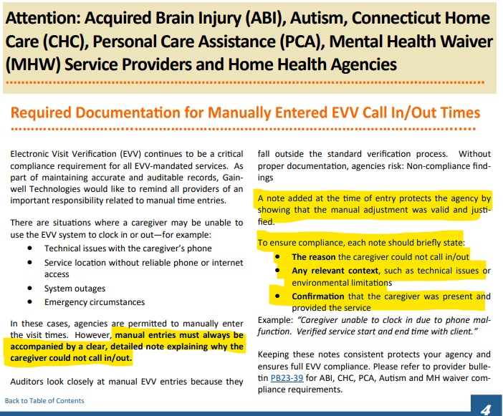
Required Documentation for Manual EVV Visits

Slide 13

MHW Advisory Council
Meets twice a year in April and October
Open to any MHW provider to send a representative
Meetings will now be held both in person and virtual. If you are interested in attending virtually, please contact Katie Daly for the link. (Katie.daly@ct.gov)
We encourage staff to identify MHW participants who might be interested in participating. Staff can bill for time spent with participant at meeting.

Slide 14
ABH Contact Information
Ann Marie Luongo, Director (general waiver info, clinician info/issues, adding staff to ABH portal)
  (860) 704-6211 aluongo@abhct.com
Emilie LeBlanc, Quality Assurance Supervisor (client eligibility, report cards, audits, notes)
  (860) 704-6123 eleblanc@abhct.com
Sarah Rasile, Program Specialist (credentialing questions, RA trainings)
  (860) 704-6157 srasile@abhct.com
Liberte Pellerin, Claims and Quality Analyst (authorization and claims issues, report cards, client eligibility)
  (860) 704-6186 lpellerin@abhct.com
Jenna Bazelais, Quality Assurance Assistant (critical incident reports, client surveys, provider surveys, report cards)
  (860) 704-6121 jbazelais@abhct.com
    FAX NUMBER 860-920-4456

