Slide 1

Mental Health Waiver
Provider Meeting
July 22, 2025

Slide 2
Agenda
Waiver Update
Average Enrolled by Month
Staffing Updates
RA Training Process
CSP Initial Training
Cultural Competency Training resource page
Communication with Waiver clinicians
Update on Peer Support credentialing requirements
Monthly RA note quality
Monthly CSP note quality/Training
MHW Advisory Council

Slide 3
Waiver Update (as of 7/21/2025)
Active participants on the waiver: 563
Actively planning for admission to waiver (MHW & MFP): 46
Referrals pending disposition (MHW & MFP): 41
Waitlisted referrals for MHW community: 0
Community Census for Waiver Year 17: 615
Additional Slots for MFP participants Waiver Year 17: 45
If you are making a referral to the MHW please remember to send in any psychosocial and functional assessments to assist with eligibility determination.

Slide 5
Staffing Updates
Laura Biggs last day will be August 7th. ABH is currently working to fill the position.
Amanda Way resigned 6/23/25 and ABH is currently recruiting a clinician for the MFP program.
DMHAS is in the process of interviewing for the Housing Coordinator position previously held by Jason Lingner.

Slide 6
RA Training process
The On Demand RA training is now live ☺
Please remember that if you have not received confirmation from ABH that staff has completed all training, that they have not been placed on the registry.
We have a number of staff who partially complete training. When you are signing up staff, please encourage them to complete the training in full as soon as possible.

Slide 7
CSP training
There will be a recording of the initial MHW CSP training added to the ABH website in the near future. We will notify CSP providers when it is available and ask that all new CSP staff review the recording before they begin seeing clients.
Please remember to verify that all new CSP staff meet the requirements before they start work:
  Bachelor’s degree in a social services field or at least 2 years experience working with the mental health population.
  Please make sure resumes verify this information and are available during re-credentialing.

Slide 8
Cultural Competency Resource Training page
ABH will be adding a Cultural Competency Resource page to the Mental Health Waiver section of their website soon. We will be adding information for CSP and RA staff to access.
Please feel free to send in any resources you would like to share with other provider agencies and we will add to our page.

Slide 9
Communication with Waiver clinicians
Please make sure your agency is communicating with waiver clinicians if there are any issues with your cases.
If there are issues with providing authorized hours or significant changes in staffing please let us know.
It is important for Waiver clinicians to know if staff are not showing consistently for shifts so they can address safety issues if necessary.

Slide 10
Peer Support updates regarding credentialing
DMHAS is updating the requirements for Peer Support Services and staff will be certified through the Connecticut Certification Board (CCB)
New PS certifications will only be provided to individuals with lived experience
Current Peer Support staff will have an opportunity to be grandfathered in beginning in May 2025
  Application and exam will be available through CCB
  Staff must have 10 hours of CEUs documented to qualify
  There will be no cost for grandfathering
On Hold

Slide 11
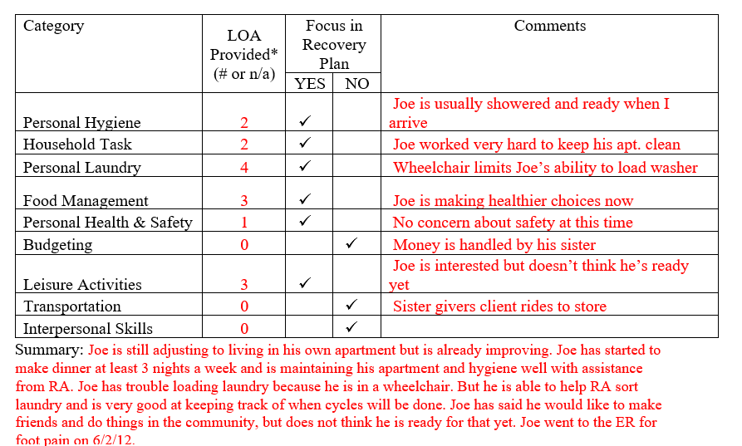
Monthly RA note quality
Please remember to provide as much information as possible to the RA monthly note. Paper RA encounter notes were discontinued with the understanding that monthly notes would sufficiently replace them.

Slide 12
Monthly CSP note quality
When writing the monthly CSP note, staff should be responding to client progress with objectives as listed in the recovery plan.
We will be developing a training for CSP monthly notes that will be recorded and used as an ongoing training tool.

Slide 13

MHW Advisory Council
Meets twice a year in April and October
Open to any MHW provider to send a representative
Meetings will now be held both in person and virtual. If you are interested in attending virtually, please contact Katie Daly for the link. (Katie.daly@ct.gov)
We encourage staff to identify MHW participants who might be interested in participating. Staff can bill for time spent with participant at meeting.

Slide 14
ABH Contact Information
Ann Marie Luongo, Program Manager (general waiver info, clinician info/issues, adding staff to ABH portal)
  (860) 704-6211 aluongo@abhct.com
Jenny DeMars, Quality Assurance Supervisor (client eligibility, report cards, audits, notes)
  (860) 704-6254 jdemars@abhct.com
Thelma Boisseau, Program Specialist (credentialing questions, RA trainings)
  (860) 638-5341 tboisseau@abht.com
Emilie LeBlanc, Claims Coordinator (authorization and claims issues, report cards, client eligibility)
  860-704-6123 eleblanc@abhct.com
Laura Biggs, Utilization Review Support (critical incident reports, client surveys, provider surveys, report cards)
  (860) 704-6182 lbiggs@abhct.com
    FAX NUMBER 860-920-4456

