Slide 1


Community Support Person (CSP) Training
CT Mental Health Waiver
2024

Slide 2
Agenda
Job Description and Role Expectations
Community Support Program visit structure
Skill Builders Toolkit
Transitional Case Management Roles & Responsibilities
Recovery Plans
Encounter & Monthly Notes
Supervision & when to contact supervisor
Boundaries
Money Follows the Person SCM & Mental Health Waiver CSC roles
Crisis/Emergency situations
Notes:
Overview of what the training will include:

Slide 3
CSP : Community Support Program
Community Support Program (CSP) consists of mental health and substance use rehabilitation services and supports necessary to assist the individual in achieving and maintaining the highest degree of independent functioning. The service provides intensive, rehabilitative community support, crisis intervention, individual psycho-education, and skill building for activities of daily living.
CSP includes a comprehensive array of rehabilitation services most of which are provided in non-office settings. Services are focused on skill building with a goal of maximizing independence. Community-based services enables the staff to become intimately familiar with the participant’s surroundings, strengths and challenges, and to assist the participant in learning skills applicable to their living environment. The services and interventions are highly individualized and tailored to the needs and preferences of the individual.
Notes:
The Community Support Program is a service that provides case management type functions, but through engaging a client and involving them in the activities as much as possible. The CSP is there to educate the client on what they need to do to maintain their benefits, services and finances, by teaching them the skills to complete the needed tasks.

Slide 4
Job description & Role Expectations
Reinforce Recovery
Build Skills
Practice Skills
Integrating Skills into Daily Living
Crisis response, hospital log, critical incident forms
Education, support & consultation to family
Psycho Education
Health & Wellness
Development of self advocacy skills
Notes:
Your role as a CSP includes:
Reinforcing recovery- helping a client learn how to manage their symptoms in a way that allows them to lead a fulfilling and productive life.
Skill Building- teaching the client skills to increase their independence.
Practicing skills- discover how they learn best and create tools to assist them.
Integration- assist them in using these skills in their day to day activities
Crisis response- help them prepare for emergency situations and complete necessary reports when required.
Working with natural supports- provide support and education to families and others as needed
Psycho Education- assist your client understand their diagnosis and ways to cope/manage symptoms
Health & Wellness- provide education and support as many of our clients have multiple health issues
Self-Advocacy- help your client to become a good advocate for themselves

Slide 5
General Knowledge expectations
Medicaid and SNAP eligibility, application process, redetermination, etc.
Social Security
Rental Assistance Program and DMHAS subsidy
Renter’s rebate, utility assistance, free cell phones, etc.
Food pantries, soup kitchens, and community resources for clothing and personal items
Mobile crisis/emergency services
Mental health and addiction treatment
Support groups and social clubs
Medical cabs and other transportation resources
Notes:
CSP staff should have a general working knowledge of the following areas: read slide

Slide 6
Rehab Domains
Housing/Living Goals
Relationship Goals
Financial/Vocational Goals
Spiritual/Religious Goals
Health Goals
Lifestyle Supports
Health Management
Nutrition
Personal Hygiene
Money Management
Care of Personal Possessions
Identifying/Navigating Transportation
Social Supports
Leisure
Rights
Medication Practices
Side Effects
Cognitive function
Quality of Treatment
Quality of Life
Community Behaviors
Personal Safety
Notes:
Your work as a Community Support Professional will span across many domains depending on the needs of your client. They may need you to assist them with paperwork each year to maintain their Section 8 voucher. You might be helping them research and develop a healthy diet plan to assist them in better controlling their Diabetes. Or you may be helping them explore places of worship in their community because religion is important to them and they want to join a congregation to meet people with similar beliefs. Regardless of the need, your objective is to provide assistance in your client’s recovery that promotes independence and self-advocacy.

Slide 7
Skills Training
What is a skill?
  Behavioral: requires action that can be seen or heard or in case of thinking skills can be described or written down
  Purposeful: done for a reason
  Transferable: can be performed or applied to many locations/situations
  Skills must be broken down into steps and taught in order
  Benefits of learning need to be described and demonstrated
Notes:
How do we promote independence? We teach skills. The skills we teach must have a purpose. The client must see the benefits to acquiring that skill. We may need to explain or demonstrate to them why the skill is necessary. We can show them how through acquiring this skill it can then be used for other situations. We may need to break down the skill into smaller steps to make it easier to learn, but the benefit of helping a client acquire a new skills outweighs the ease of simply doing everything for them.

Slide 8
Structure of skill building sessions
Informal socialization and identification of any major problems/concerns
(1-3 minutes)
Review previous session (1-3 minutes)
Review homework (3-5 minutes)
Follow-up on goals (1-3 minutes)
Set agenda for current session (1-2 minutes)
Teach new material or review previously taught material (30-40 minutes)
Agree on new homework assignment (3-5 minutes)
Summarize progress made in current session (3-5 minutes)
Notes:
Our visits need to be structured so the goal is clear and the time is productive. We are not there to simply “check in” with the client. This slides gives an example of how a visit might look. This structure sets an agenda, provides education and sets up future sessions. Following this structure will also assist you in writing the required encounter note for your visit.

Slide 9
The Process
What we do…..
  Engage and educate
  Assess need, educate, interest and commitment
  Provide support and shared decision-making to develop recovery goal(s) and work with the person
  Provide treatment, Case Management and other services as needed, that support goal(s) and help reduce barriers
  Connect to community resources as needed
  Provide support to maintain goal and change/progress
Notes:
The focus is to be on skill building and allowing the client to live independently and safely in the community. We are following a client-centered model. It is important to be open and honest in order to build a healthy and open relationship. You are essentially modeling ways to connect and communicate. By being supportive and caring it helps to break the belief that only conditional support happens for them to receive acceptance. Be sure to reflect thoughts and feelings back to the client as this technique helps client's gain a better understanding of their own thoughts, feelings and perceptions. Through empathetic understanding client’s self-awareness increases which allows for change. Our goal is to increase self-acceptance and self-esteem, personal growth and self-expression, minimize negative feelings (such as defensiveness, regret, guilt, and insecurity) and create a better understanding and trust in oneself.

Slide 10
The Process : What the consumer does
Determines their readiness to engage in recovery – change/hope/confidence
Works on getting ready if not ready right now – building up the idea/hope of recovery/change
Chooses a goal for themselves – an environment based role
Plans for how to reach goal – determine what kinds of help they need and what they need to learn
Learn skills and develops supports
Maintains their recovery/skill goal
Notes:
Client-centered model reinforces the practice that the client is best able to decide what to explore and how. Techniques often used include non-directiveness or refraining from asking directive questions or engaging in advice-giving and lets the client direct the direction of the visit. The client is the one that is driving the process while you are there to help them navigate and provide skills and techniques that the client can then utilize. The goal is to promote self-confidence, self-acceptance and self-discovery.

Slide 11
Rehabilitation Focus
Focus is on teaching not providing – cueing, reminding, training, overcoming barriers
Clearly rehabilitative, not medical/clinical
Organized approach to development of new or redevelopment of old competencies
Not clinically focused although clinical services may play an integral or supportive role in treatment (referenced separately)
Symptom reduction is not the focus – symptom and disability self-management are.
Must focus on restoration/improvement of functioning
Notes:
Read slide

Slide 12
Skill Builders Toolkit
The Individual Recovery Plan of every individual on your caseload – de-identified, of course.
Notebook of favorite curriculum(s), skill lists, role play ideas, homework assignments, etc.
Blank homework assignment sheets.
To Do Lists: to use as reminders to contact other providers about case management, doctors and other needs.
Paper, pen, pencils & markers- for writing out steps, lists, etc. so they are visible to both you and the individual.
Other items?.....visual aids (posters, flashcards, etc.), easel paper, sticky notes, etc.
Notes:
Here are some things you should consider bringing with you to your CSP visits: read slide

Slide 13
TCM: Transitional Case Managment
Community cases during hospital stay/rehab:
  Attend discharge planning meetings
  Update CSC on client progress
  Assist client with transition back to apartment
Skilled Nursing Facility cases prior to enrollment:
  Attend discharge planning meeting
  Assist housing coordinator with apartment viewing and set up
  Assist client with setting up utilities
  Assist with coordination of aftercare appointments
  Assist client on day of transition
Notes:
Transitional Case Management is a service we are able to provide either before a client comes onto the Mental Health Waiver from a nursing home or while a client is hospitalized during his time on the Mental Health Waiver. Some duties you may expect to provide as a TCM are as follows: read slide

Slide 14
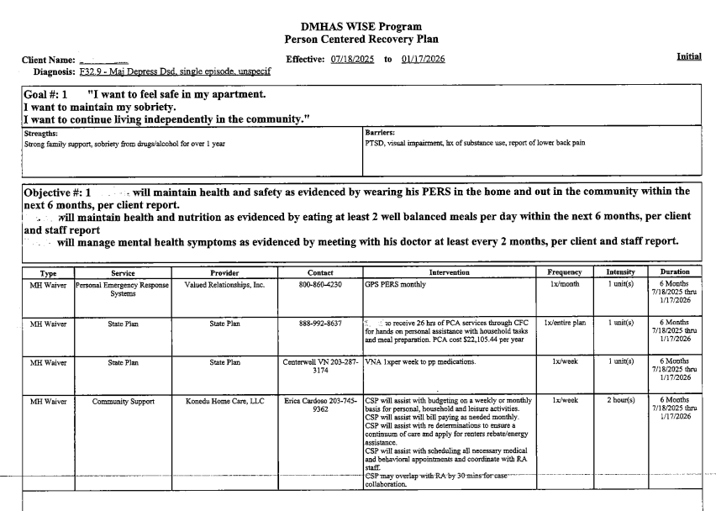
Recovery Plan
Notes:
This is a sample of a Recovery Plan for the Mental Health Waiver.
The first section lists the Goals determined by the client and stated in their own words. Any strengths toward achieving those goals and barriers that may prevent them from obtaining those goals are identified.
Based on the goals, objectives are then created. These are things the client will be working on to achieve their goals. Objectives are written in measurable terms so that the team can better identify progress. These objectives and their progress are important to focus on when planning your visits and writing your encounter and monthly notes.
All of the services the client is receiving from the waiver are listed along with specific interventions for each service. You and the client will refer to these interventions when planning your visit and activities.
The client should have a copy of their current plan in their home for reference. If you do not have access to a plan for your client, please let your supervisor know so that you can be given a copy.

Slide 15
Treatment Plan Reviews
Mandatory Review of the plan at clinically appropriate intervals (at least every 6 months) with the Mental Health Waiver Community Clinician and the Client
  Determine effectiveness based on progress
  Use monthly progress notes –
  Re-evaluate appropriateness and currency
  Cannot do it without input of client
Plan revisions
  Revisit the client goal(s)
  Re-examine needs
  Change and update rehab goals (outcomes) and objectives
  Look for new interventions and modalities
  Adjust the time frames and target dates
Plan should change – whether it is working or not!
Notes:
Treatment plan reviews with the MHW happen at 6 month intervals (initial, 6 month and annual). These reviews provide opportunities to review the current care plan, discuss as a team how things are going, and make any necessary changes. Attendees will include the MHW clinician, CSP and client and anyone else the client or team may feel is appropriate to join the meeting. Sometimes that includes supportive family members, conservators, behavioral health clinicians, nurses etc.

Slide 16
Two kinds of Notes:
Encounter (Billing) Notes
Real-time notes of interventions related to the Recovery Plan
Completed by the person who performs the intervention. Client can participate/contribute.
Monthly Progress Notes
Summary of progress toward Recovery Plan Goals and Objectives
Completed and signed by Licensed/Licensed eligible Clinical Staff (CST clinical supervisor), in conjunction with other staff and client
Serves as documentation of progress and of supervision.
Notes:
These notes are vital to the overall progression of the client’s independence. It serves as a marker for what interventions have been successful, which have not, highlights areas where improvements or changes can be made or adjusted. The MHW clinician reviews these notes in order to get a better sense of what is going on with the client’s care plan during times when they are not as actively involved in the day to day, or month to month care that is being given by the providers. It serves as a recap in preparation for the reviews.

Slide 17
Encounter Note vs Progress note
Encounter Note
Date of service
Signature of Provider
Date of Signature
Description of skill building
Description of client’s
response to intervention
objective
Next steps/plan
Monthly Progress Note
Dates of Included
Services
Signature of writer and signature of licensed or licensed-eligible supervisor if not the writer
List of each goal and
Intervention
Progress towards goals and objectives
Notes:
Two types of notes are required for the CSP service. Encounter notes are notes you will complete after each visit. They will be a record of the time you spent with the client, the skill building provided, how the client responded to the intervention and your plans for the next visit.
Monthly Progress notes are completed at the end of each month you provide CSP service for a client. In these notes you will comment on each goal/intervention you worked on with the client that month and the progress that has been made.

Slide 18
Encounter notes
Encounter Notes
Minimum requirements
  Date
  Actual Time (Length)
  Location
  Individuals present
  Goal/objective addressed
Type of service
General description of what was done
Client’s response
Next Steps/plan
Signature & Credential of providing person
Notes:
The outline of the Encounter Note follows the outline of a typical CSP visit. Having this outline also helps you as the CSP to keep track of your own progress with the client, or keep record of what to review/reinforce in future visits.
A client’s response is shown and reinforces that we are working from a client centered model. Utilizing client’s own words or actions personalizes the note and links it directly to the specific goal or skill that is being worked on, or being resisted.

Slide 19
Monthly Progress Notes
Once per month and as needed
Reflect the treatment plan including consumer reaction and choice
Summarize interventions and response; Outline progress (if any) toward goals and objectives
Recommend modifications to rehabilitation plan as necessary
Signed by Licensed or licensed eligible Clinician
Excellent opportunity to reinforce progress and review goals and objectives with client.
If significant issues are occurring that aren’t on the plan – revise the plan!
Face-to-face review time with client is counted as rehabilitation service.
Notes:
Monthly Progress notes are reviewed by the assigned Community Support Clinician so they can be updated on the client’s progress in between review meetings. It is your opportunity to summarize the progress that the client has made over the previous month as well as mention any issues that may need to be addressed. This is also a good time to review the month with your client and outline plans and goals for the next month.

Slide 20
Make sure to show Progress
Not so Good: “John continues to make progress.”
Better: “John is now able to initiate deep breathing and visual imaging of fishing with cousin 50% of the time without prompting when he becomes anxious at the grocery store.”
Better: “John is correctly using his meal planning
guide to select healthy foods with very little
assistance. He asks me to check his work and I
seldom find errors.”
Notes:
Make sure your notes are giving specifics when demonstrating progress. The objective section of the Recovery Plan should contain concrete measures for progress. Comment specifically on where the client is at in achieving those markers. For example: instead of stating the client is making progress in meal planning say something like “John chooses to select healthy foods from his Diabetic Meal Planning guide at least 50% of the time.”

Slide 21
Documentation Narrative
The narrative of the documentation should tell you what service is being delivered.
Interventions in narrative should match up with those described in service definitions.
Documentation should clearly spell out that this is rehabilitation.
Assessments and treatment plans should explicitly point to the covered services.
A Supervisor’s job is to ensure staff know which service to do when, and how to write it.
Notes:
Read slide

Slide 22
CSP Supervision
Services are delivered under the supervision of a licensed or licensed-eligible professional who may be the team leader or a member of the team.
Clinical supervision shall occur at least monthly as evidenced by the supervisor’s signature on a monthly progress note documenting the individual’s progress toward meeting treatment plan goals and objectives
Notes:
Supervision provides opportunity for education, coaching, counseling and directing. Supervision is a time for case review and sharing of issues or concerns. Supervision is a shared responsibility and should be conducted regularly with minimal interruptions. It involves four functions: management, development, mediation and support.

Slide 23
Boundaries
Self-awareness
Communication skills
Assertiveness
Building rapport – interpersonal skill development
Set Limits
Notes:
Setting boundaries defines our expectations of ourselves and others in different kinds of relationships. Setting healthy boundaries is crucial for self-care and building positive working relationships. It is important to remember you are the professional and that you are developing a working relationship that promotes the health and safety of the client. Many of our clients struggle with establishing and maintaining healthy and appropriate boundaries. You modeling this behavior in your work and practice with them, will help model this skill for the client as well as establishing your roles. Setting healthy boundaries requires self-awareness. You need to be clear about your expectations and what you are and are not comfortable with. This will require communication skills that convey assertiveness and clarity. Assertiveness involves expressing your feelings openly and respectfully and it also requires active listening. Be as clear and straightforward as possible. State your expectation or request directly in terms of what you’d like, rather than what you don’t want or like. Maintaining professional boundaries protects the client’s interests and your self-care. Set limits on how much time you are able and willing to spend on certain tasks.
Ex. Schedule length and time of a session, limits of personal disclosure, limits regarding the use of touch, respecting client’s personal space and home environment, prioritize tasks to be worked on.
Ex. Of what not to do (respectfully decline) – do not accept gifts, money (gas money), no personal or sexual relationships.

Slide 24
Role of MFP SCM and MHW CSC
  Determine Skilled Nursing Facility Level Of Care
  Develop Recovery Plan
  Order waiver services
  Modify Plan
  Modify Authorizations
  Monitor costs
  Please remember that the CSP should have a clinical supervisor to turn to for assistance and the client has a clinical provider to contact for clinical needs/issues.
Notes:
It is important to remember that the MFP SCM or MHW CSC is not your clinical supervisor. That person is provided to you from your agency for supervisory purposes. The role of the SCM or CSC is as follows: read slide

Slide 25
Crisis Intervention/documentation
What constitutes a crisis situation? Any change in behavior/environment that puts the client/staff at possible health/safety risk
When to consult with supervisor regarding a crisis situation? ALWAYS
Who to notify?
  Supervisor
  CSC
  Conservator (if one is involved)
  Behavioral Health Clinician/therapist
  Nursing services
Notes:
Read Slide

Slide 26
Examples of Critical Incidents
  death;
  suicide (including attempts);
  threats to self or others;
  abuse/neglect/exploitation of client;
  missing persons;
  involvement of emergency services/law enforcement (EMTs/Fire/Police);
  criminal activity (perpetrator/victim/witness, etc.);
  incarceration
  falls (even if client refuses medical treatment)
  ANY unplanned medical treatment (ED visits, inpatient treatment, SNF stays – both medical & psych!)
  medication errors (wrong meds, not taking meds, out of meds, etc.)
  property damage
  unusual client behavior (suddenly manic? paranoid? selling all their possessions? etc.)
Notes:
Here are some examples of events regarded as Critical Incidents by the Mental Health Waiver: Read Slide

Slide 27
Critical incident report
What is a critical incident report?
  Report is to be filed within 48 hours of incident
  All parties needing to be notified and when (voicemail, email)
  Who, what, where, when & how incident occurred
  Provide as much detail as possible in the narrative, including what steps were taken to address the incident and any follow up that is suggested.
  Documentation to be LEGIBLE
  ABHCT.com – fillable word document / additional Critical incident training powerpoint
Notes:
If filling out an incident report by hand, be sure your penmanship is legible. Often times we get reports and it is very hard to read and understand when hand writing is poor. These documents are uploaded into an electronic system which can sometimes distort one’s handwriting. These are professional documents so be mindful of your penmanship. We also have located on the ABH website under Mental Health Waiver forms, a fillable document that can be completed on using the computer. This is the preferred method for filling out the form but we understand no everyone may have access to a computer when in the field.

Slide 28
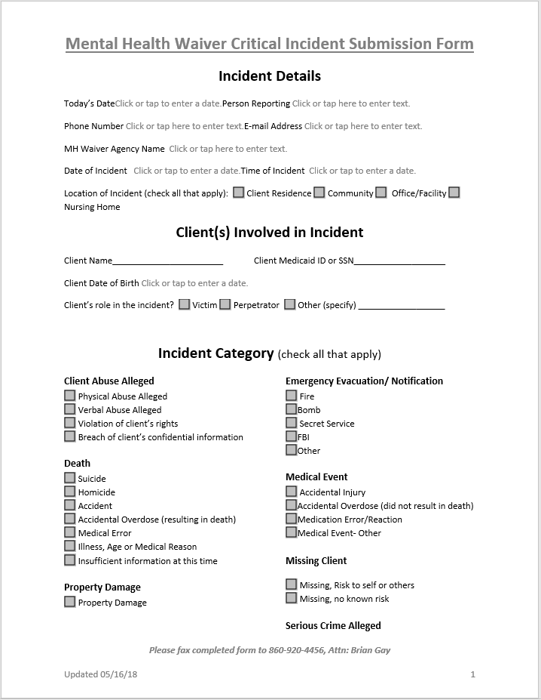
Critical Incident Form
Must complete all sections:
  Date Report is completed
  Person reporting
  Contact information (phone & e-mail)
  Agency name (should not be ABH)
  Date & Time of Incident
  Location of Incident
  Client Info (name, DOB & WOS ID)
  Client’s role in the incident
  Incident Category (please check one)
Notes:
Read slide

Slide 29
Critical Incident Narrative
Be thorough but concise
Include any relevant details
  If a medication error: Which meds? How long without meds? What led to the error? Is it resolved?
  If a hospitalization: Was client admitted? Were they discharged? What’s the plan for follow up care/monitoring?
  If a staffing issue: Which staff were involved? Which agencies? Has the issue been resolved? Has staff been reassigned, reprimanded, or terminated?
Write in the third person
  Refer to MHW participant as “client” or use their name.
Use proper spelling & grammar
Give facts not opinions/impressions (“client was rude”, “called me out of my name”)
Write legibly – better yet, TYPE.
Reports which are incomplete, illegible or offer insufficient detail will require follow-up
Notes:
Read Slide

Slide 30
Mobile Crisis
Available 24/7, 365 days a year
1-800-HOPE-135 (1-800-467-3135)
211
Listed by town with corresponding mobile crisis agency that covers that area: https://link.zixcentral.com/u/35127723/eBQxfhsS7xGzVY4RYVsSiw?u=https%3A%2F%2Fportal.ct.gov%2FDMHAS%2FPrograms-and-Services%2FFinding-Services%2FFinding-Services
Access Line – 24/7 access to substance use treatment, including detox and transportation 1-800-563-4086
Call or text 988 – for suicide & crisis
Notes:
Mobile crisis is a statewide service that serves adults who are d18 years of age or older. The provide immediate assistance to people in distress by identifying options and resources that meet the unique needs expressed by the individual. Mobile crisis teams (MCT) are mobile, readily accessible, short-term services for individuals and families experiencing acute mental health and/or substance use/addiction crises. They are compromised of a multidisciplinary team which may include licensed master’s level social workers, licensed clinical social workers, licensed professional counselors, peer support specialties, nurses, mental health workers and psychologists.
Other important numbers to be familiar with – access line for substance use treatment, detox. Dial 988 for suicide & crisis.

