Slide 1

Mental Health Waiver
Provider Meeting
May 1, 2026

Slide 2
Agenda
Waiver Update
Average Enrolled by Month
Staffing Updates
Waiver renewal
TCM billing: MFP vs Community
RA Training Process
Access to ABH website
Update on Peer Support credentialing requirements
Critical Incident Reports
Documenting manually entered visits in EVV
MHW Advisory Council

Slide 3
Waiver Update (as of 4/27/2026)
Active participants on the waiver: 564
Actively planning for admission to waiver (MHW & MFP): 39
Referrals pending disposition (MHW & MFP): 64
Waitlisted referrals for MHW community: 4
Community Census for Waiver Year 17: 615
Additional Slots for MFP participants Waiver Year18: 45
If you are making a referral to the MHW please remember to send in any psychosocial and functional assessments to assist with eligibility determination.

Slide 5
Staffing Updates
Emily Leblanc has been promoted to Quality Assurance Supervisor at ABH (position previously held by Jenny Demars)
Liberte Pellerin has started in the Claims & Quality Analyst position previously held by Emilie.
Katie Daly has accepted the position of Clinical Director of Long-Term Services and Reports at DMHAS previously held by Erin Leavitt-Smith.
DMHAS will be posting for the Behavioral Health Clinical Supervisor position previously held by Katie Daly.
ABH is currently recruiting for the MFP SCM position in the New Haven area.

Slide 6
Waiver Renewal
The current Mental Health Waiver will expire on March 31, 2027.
DMHAS will begin the renewal process this spring and will be requesting another 5-year renewal (effective 4/1/27-3/31/32)
DMHAS is considering the addition of agency based PCA services.
Ideas?

Slide 7
TCM Billing
If you have provided TCM services to a client who is transitioning out of a SNF and onto the waiver, you will need to bill all your TCM hours on the day of discharge. This will mean you also need to manually enter a Sandata visit for that day with the full number of hours.
Example: Your agency provided 20 hours of TCM prior to client being discharged from the nursing home on 2/1/26 and provided 2 hours on the day of discharge. You would manually enter a visit for TCM on 2/1/26 for 22 hours and bill as usual.
For clients already enrolled on the Mental Health Waiver, you can schedule TCM visits and bill as you would any other service.
Example: you have a client who enters a nursing home for 30 days post-surgery. They were already receiving MHW services prior to the surgery. You can schedule the TCM visits as authorized and billing can occur as service is provided.
Please remember that TCM is not meant to replace the CSP authorization in terms of hours, and should be used for work related to discharge planning (checking on client progress, meeting with SNF social worker, attending discharge planning meetings, etc.)

Slide 8
RA Training process
The On Demand RA training is now live ☺
Please remember that if you have not received confirmation from ABH that staff has completed all training, that they have not been placed on the registry.
We have a number of staff who partially complete training (about 37%). When you are signing up staff, please encourage them to complete the training in full as soon as possible.

Slide 9
Access to ABH website
CSP and administrative staff that need access to the ABH website for notes, recovery plans, etc. should be logging into the site at least every month.
Please only request access for staff that will need to use the site on a regular basis as ABH is required to pay a fee per user.
Users who do not sign in on a regular basis will have their accounts deactivated.
Please inform us when staff who have access leave your agency so we may deactivate their accounts immediately.

Slide 10
Peer Support updates regarding credentialing
DMHAS is updating the requirements for Peer Support Services and staff will be certified through the Connecticut Certification Board (CCB).
Anyone who completes a DMHAS-approved training on or before February 1, 2026 is eligible. Must submit application by October 1, 2026.
To apply: Grandparenting application on CCB website https://yalesurvey.ca1.qualtrics.com/jfe/form/SV_e8lz9kDCi4bBOGa
Required Documents: State or Federal Picture ID and Training Completion Certificate
No Test!!! No CEUs needed!!!

Slide 11
Critical Incident Reports
Please remember that we request a CI report for each unplanned hospital admission.
Recording on Critical Incident Report training can be found on the ABH website and this link: https://www.youtube.com/watch?v=HmouHoz8mxc
The CI Report form can be found on the ABH website and this link: https://www.abhct.com/programs-services/mental-health-waiver-wise-forms/

Slide 12
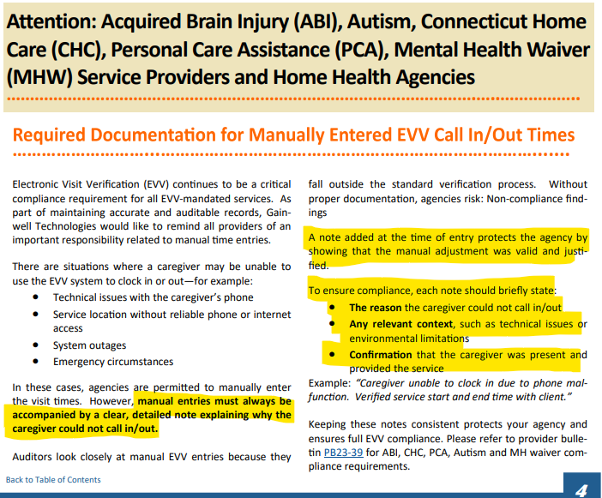
Required Documentation for Manual EVV Visits

Slide 13

MHW Advisory Council
Meets twice a year in April and October
Open to any MHW provider to send a representative
Meetings will now be held both in person and virtual. If you are interested in attending virtually, please contact Katie Daly for the link. (Katie.daly@ct.gov)
We encourage staff to identify MHW participants who might be interested in participating. Staff can bill for time spent with participant at meeting.

Slide 14
ABH Contact Information
Ann Marie Luongo, Director (general waiver info, clinician info/issues, adding staff to ABH portal)
  (860) 704-6211 aluongo@abhct.com
Emilie LeBlanc, Quality Assurance Supervisor (client eligibility, report cards, audits, notes)
  (860) 704-6123 eleblanc@abhct.com
Sarah Rasile, Program Specialist (credentialing questions, RA trainings)
  (860) 704-6157 srasile@abhct.com
Liberte Pellerin, Claims and Quality Analyst (authorization and claims issues, report cards, client eligibility)
  (860) 704-6186 lpellerin@abhct.com
Jenna Bazelais, Quality Assurance Assistant (critical incident reports, client surveys, provider surveys, report cards)
  (860) 704-6121 jbazelais@abhct.com
    FAX NUMBER 860-920-4456

