Slide 1
Mental Health Waiver Provider Meeting
April 29, 2025

Slide 2
Agenda
UCONN Research Department
Waiver Update
Average Enrolled by Month
Staffing Updates
RA Training Process
Use of secure email/new ABH secure email
Communication with Waiver clinicians
Update on Peer Support credentialing requirements
Monthly RA note quality
MHW Advisory Council

Slide 3
UCONN Research Department
Survey Questions feedback

Slide 4
Waiver Update (as of 4/28/2025)
Active participants on the waiver: 579
Actively planning for admission to waiver (MHW & MFP): 34
Referrals pending disposition (MHW & MFP): 35
Waitlisted referrals for MHW community: 10
Community Census for Waiver Year 17: 615
Additional Slots for MFP participants Waiver Year 17: 45
If you are making a referral to the MHW please remember to send in any psychosocial and functional assessments to assist with eligibility determination.

Slide 6
Staffing Updates
Thelma Boisseau will be taking an extended leave shortly. Please make sure Ann Marie Luongo (aluongo@abhct.com) is included on all emails to her.

Slide 7
RA Training process
The On Demand RA training is now live ☺
Please remember that if you have not received confirmation from ABH that staff has completed all training, that they have not been placed on the registry.
We have a number of staff who partially complete training. When you are signing up staff, please encourage them to complete the training in full as soon as possible.

Slide 8
Use of secure email
Please remind staff that if personal client information is needed to be included in an email, that the email should be sent securely.
Personal information includes: name, date of birth, social security number, Medicaid number.
Remember to check the subject line-no PHI should appear there.
WOS ID numbers are not identifiable and can be used safely in email communication if needed.

Slide 9
Communication with Waiver clinicians
Please make sure your agency is communicating with waiver clinicians if there are any issues with your cases.
If there are issues with providing authorized hours or significant changes in staffing please let us know.
It is important for Waiver clinicians to know if staff are not showing consistently for shifts so they can address safety issues if necessary.

Slide 10
Peer Support updates regarding credentialing
DMHAS is updating the requirements for Peer Support Services and staff will be certified through the Connecticut Certification Board (CCB)
New PS certifications will only be provided to individuals with lived experience
Current Peer Support staff will have an opportunity to be grandfathered in beginning in May 2025
Application and exam will be available through CCB
Staff must have 10 hours of CEUs documented to qualify
There will be no cost for grandfathering
On Hold

Slide 11
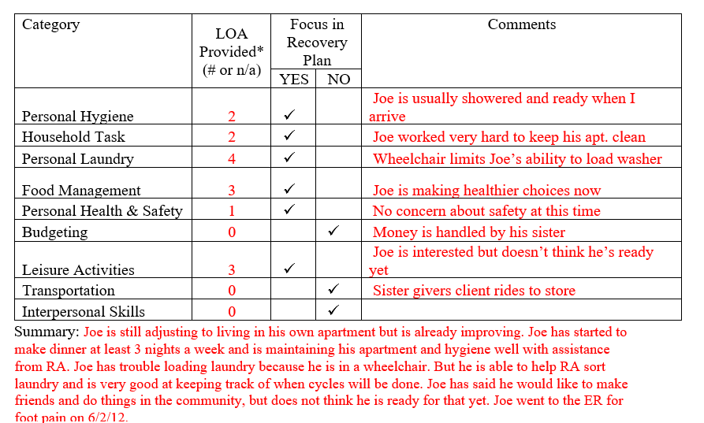
Monthly RA note quality
Please remember to provide as much information as possible to the RA monthly note. Paper RA encounter notes were discontinued with the understanding that monthly notes would sufficiently replace them.

Slide 12
MHW Advisory Council
Meets twice a year in April and October
Open to any MHW provider to send a representative
Meetings will now be held both in person and virtual. If you are interested in attending virtually, please contact Katie Daly for the link. (Katie.daly@ct.gov)
We encourage staff to identify MHW participants who might be interested in participating. Staff can bill for time spent with participant at meeting.

Slide 13
ABH Contact Information
Ann Marie Luongo, Program Manager (general waiver info, clinician info/issues, adding staff to ABH portal)
(860) 704-6211 aluongo@abhct.com
Jenny DeMars, Quality Assurance Supervisor (client eligibility, report cards, audits, notes)
(860) 704-6254 jdemars@abhct.com
Thelma Boisseau, Program Specialist (credentialing questions, RA trainings)
(860) 638-5341 tboisseau@abht.com
Emilie LeBlanc, Claims Coordinator (authorization and claims issues, report cards, client eligibility)
860-704-6123 eleblanc@abhct.com
Laura Biggs, Utilization Review Support (critical incident reports, client surveys, provider surveys, report cards)
(860) 704-6182 lbiggs@abhct.com
FAX NUMBER 860-920-4456

