Slide 1
MHW Critical Incidents
Presented by:
Ann Marie Luongo, Program Manager for MHW, ABH

Slide 2
Critical Incidents (CI) - what are they?
A Critical Incident (CI) is defined as:
An incident that may have a real or potential serious impact on Waiver participants, staff, facilities, funded agencies, or the public or may bring about adverse publicity.

Slide 3
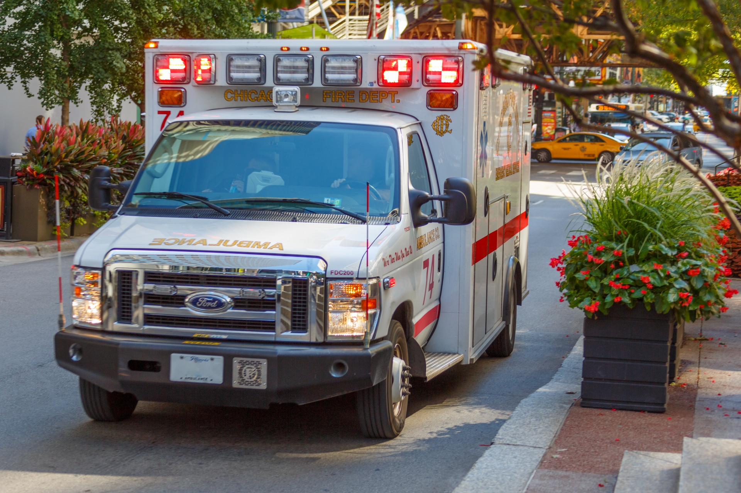
Critical Incidents (CI) - Examples
Examples of CI include but is not limited to:
death;
suicide (including attempts);
threats to self or others;
abuse/neglect/exploitation of client;
missing persons;
involvement of emergency services/law enforcement (EMTs/Fire/Police);
criminal activity (perpetrator/victim/witness, etc.);
incarceration
falls (even if client refuses medical treatment)
ANY unplanned medical treatment (ED visits, inpatient treatment, SNF stays – both medical & psych!)
medication errors (wrong meds, not taking meds, out of meds, etc.)
property damage
unusual client behavior (suddenly manic? paranoid? selling all their possessions? etc.)
When in doubt? Submit one anyway!
Notes:
You do not need to file a critical incident report for a planned hospital visit or stay.

Slide 4
Critical Incidents (CI) – Timely Reporting
Please submit written report to ABH within one business day of becoming aware of incident occurring
Fax to 860-920-4456 attn: Critical Incident
E-mail to MHWcriticalincident@abhct.com
Untimely reporting may lead to disciplinary action up to and including a corrective action plan and/or placing the provider agency on hold.

Slide 5
Critical Incident section on ABH website

Slide 6
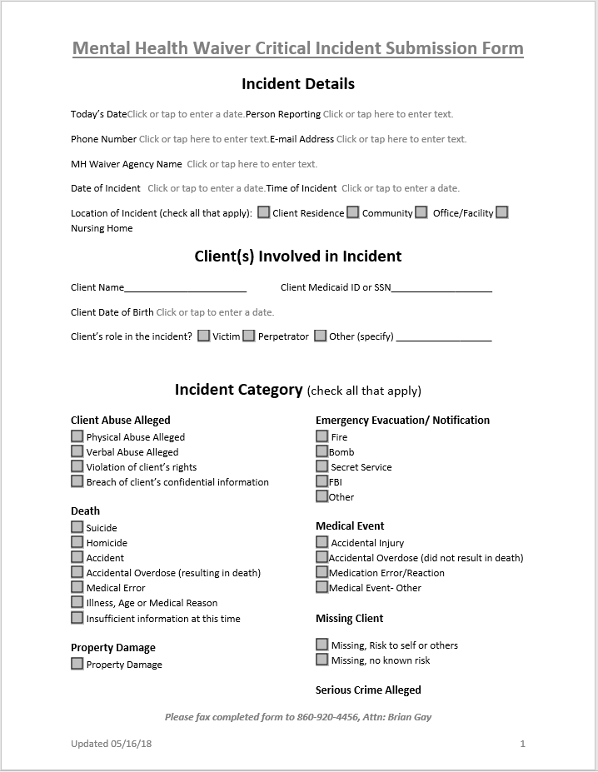
Critical Incidents (CI) – The Form
Must complete all sections:
Date Report is completed
Person reporting
Contact information (phone & e-mail)
Agency name (should not be ABH)
Date & Time of Incident
Location of Incident
Client Info (name, DOB & WOS ID)
Client’s role in the incident
Incident Category (please check one)

Slide 7
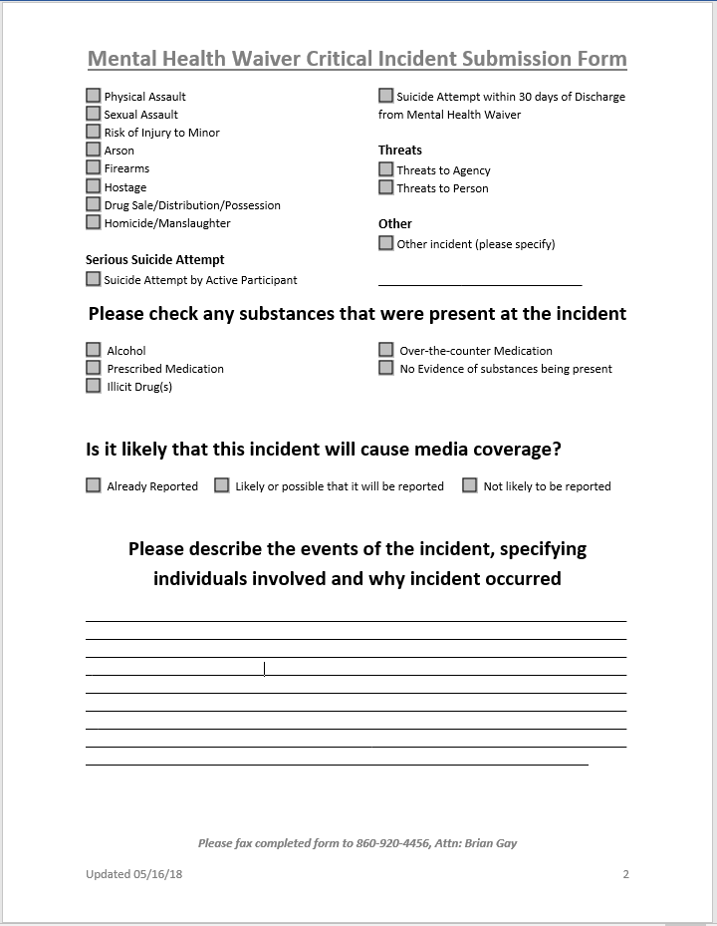
Critical Incidents (CI) – The Form (cont.)
Any substances present?
Media attention likely?
Narrative
First Provider notified is expected to complete the form, whether or not they were present at time of incident. Collaboration with another agency to gather information may be required.

Slide 8
Critical Incidents (CI) – Narrative
Be thorough but concise
Include any relevant details
If a medication error: Which meds? How long without meds? What led to the error? Is it resolved?
If a hospitalization: Was client admitted? Were they discharged? What’s the plan for follow up care/monitoring?
If a staffing issue: Which staff were involved? Which agencies? Has the issue been resolved? Has staff been reassigned, reprimanded, or terminated?
Write in the third person
Refer to MHW participant as “client” or use their name.
Use proper spelling & grammar
Give facts not opinions/impressions (“client was rude”, “called me out of my name”)
Write legibly – better yet, TYPE.
Reports which are incomplete, illegible or offer insufficient detail will require follow-up

Slide 9
Critical Incidents (CI) – Narrative (cont.)
Example of a strong narrative:
“Writer received a call 1) from [client] who reported that 2) on Tuesday (10/9/18) while 3) at the laundromat, he 4) had a stroke and was reportedly 5) brought to HH by a Good Samaritan. [Client] reported that 6) he "signed himself out" of the hospital last night (10/11/18) because he "did not like the care there" and was driven home by a friend. 7) Writer prompted [client] to schedule a follow-up appointment with his neurologist and will ensure that CSC and CSP are aware of incident.”
1) Who reported?
2) When did incident occur?
3) Where did incident occur?
4) What happened?
5) Was client hospitalized? How transported?
6) Was client discharged? When?
7) Follow up?

Slide 10
Critical Incidents (CI) – Narrative (cont.)
Example of a weak narrative:
“Client doesn't know how he broke his foot. He may have broke his foot when he walked to his mailbox barefoot. That is just a guess. The client was the only person at the scene. He identified the problem in his apartment.”
Was client hospitalized? If so was he admitted?
What is client’s current status?
What steps are being taken to obtain additional information?
What is the plan for follow up care?

Slide 11
Critical Incidents (CI) – Follow Up
Reported to & reviewed by DMHAS leadership on a weekly basis
Monitored for trends (current trends: falls & med errors)
Certain cases flagged for follow up
Clinician notified in order to reach out to Providers
Providers may need to gather additional information and/or provide intervention as needed
Provider reports back to clinician with updates
Clinician reports back to leadership with updates
If not resolved within two weeks, additional follow up/intervention will take place

Slide 12
Critical Incidents (CI) – CONNIE
Process
Notifications are received for every client hospitalization
Hospital log is updated with relevant info (admission/discharge)
ABH notifies CSP & CSC of update in hospital log
CSP investigates hospitalization and submits a CI report regarding incident if one has not already been filed
CI report is then processed as usual
Timely reporting (one business day) is still expected for CI reports documenting these hospitalizations
CSP is expected to investigate and report, even if not present for incident

Slide 13
Questions?
Contact for Critical Incident Reports:
Laura Biggs
lbiggs@abhct.com
860-704-6182

