Slide 1
Mental Health Waiver Provider Meeting
July 26, 2022

Slide 2
Agenda
Waiver Update
Average Enrolled by Month
Waiver Staffing changes
HCBS Rate updates
Staffing Availability
Virtual vs in person visits
RA Training Process
Waiver clinician requests for staff re-education
Gainwell Re-credentialing
EVV
MHW Advisory Council

Slide 3
Waiver Update (as of 7/25/2022)
Active participants on the waiver: 565
Actively planning for admission to waiver (MHW & MFP): 38
Referrals pending disposition (MHW & MFP): 41
Waitlisted referrals for MHW community: 0
Community Census for Waiver Year 14: 615
Additional Slots for MFP participants Waiver Year 14: 45
If you are making a referral to the MHW please remember to send in any psychosocial and functional assessments to assist with eligibility determination.

Slide 5
Waiver Staffing Changes/Updates
New Haven/Bridgeport CT CSC (ABH): Ellen Hughes 860-819-6800 ehughes@abhct.com
DMHAS MHW Program Manager: interviews in process

Slide 6
HCBS Rate Updates
As DSS has completed their work with the ARPA funds, they will now resume completing the work that was started on rate modifications to reflect the outcomes of the Rate Methodology study that was conducted.
Some rates were recently updated to reflect the minimum wage increase effective 7/1/22
The RA overtime rate (1213M:TU) was implemented during COVID as a precaution to account for increased staff outages that might require a staff person to work with an individual more than 40 hour per week. It only applies if a RA works with the same client for more than 40 hours per week, not multiple clients. We have not used this code to date and did not anticipate having to use it. If you have a client assigned more than 40 hours per week and find that you may be required to pay overtime, please alert the MHW clinician.

Slide 7
Staffing availability
Please keep ABH updated as to your ability to accept new referrals for CSP and RA services.
Please be honest about your ability to provide the services that are being requested.
Please alert us if one of your staff has tested positive for COVID-19 and which participants they may have had contact.
Please keep ABH updated of any contact/supervisor changes.
Anyone who has an ABH account (WOS and DUO) must login in at least every 90 days or their account will be de-activated.

Slide 8
Monthly Progress Notes
There was definite improvement in monthly note submissions. Thank you everyone for your hard work!
Please remember that supervisors should be reviewing monthly notes to insure completion and quality. All supervisors should have access to the system.
Individual agencies that have not met the standards will informed of next required steps.
Examples of completed Monthly notes can be found on the ABH website for staff review.

Slide 9
Virtual vs in person visits
It is expected at this time that all clients are receiving in person visits. If a client is requesting that visits continue to be held virtually, please contact the CSC assigned to the case immediately so that the situation can be assessed and brought to DMHAS leadership if necessary for review.
If there is a need for a visit to be held virtually, please remember that the CSC assigned to the case should be contacted to determine appropriateness.

Slide 10
RA Training process
Agencies are now required to also check Sex Offender Registry status.
For Agency trainings:
Submit CBCs and training roster before conducting training to ABH for approval
Notify ABH when training has been completed and submit attendance roster.
ABH will notify agency when staff pass post-test.
For ABH trainings:
Submit CBC and preferred training date to Maria Michaud (mmichaud@abhct.com) to register staff for upcoming trainings.
ABH will send an email to all registrants the afternoon before the training day with sign in information. ABH will alert agencies once staff have completed training and passed post-test.

Slide 11
Requests from Waiver Clinicians
Please make sure CSP and RA staff are aware of the Recovery Plan and have reviewed it.
Transportation is not a waiver service. While it is up to individual agencies if they allow their RA staff to transport, our focus continues to be teaching how to access community transportation. We cannot continue to keep people on the waiver because they want transportation.
Meal Preparation is a qualifying need for our waiver and should be a task in which RA staff are actively providing support.

Slide 12
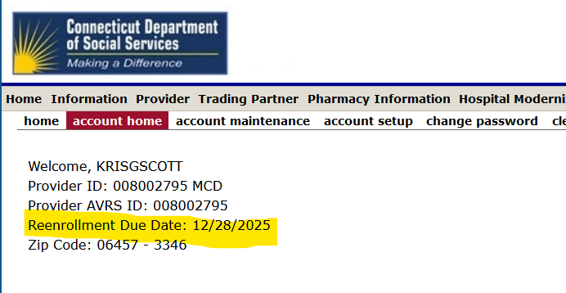
Gainwell Re-credentialing
While ABH still credentials provider agencies for the Mental Health Waiver, please remember that you must now re-credential with Gainwell every 2 years for billing purposes.

Slide 13
Electronic Visit Verification
Please make sure that you are changing client status from pending to active in Sandata. We are getting a number of calls from provider agency staff stating that there is not an authorization for client when the issue is that the client is still in pending status.
Staff should be using the client’s phone or their mobile app to check in and out. There are a number of visits in EVV that agencies are manually entering and confirming. If you are having trouble with clients letting staff use their phones, please speak to their waiver clinician.

Slide 14
MHW Advisory Council
Meets twice a year in April and October
Open to any MHW provider to send a representative
We encourage staff to identify MHW participants who might be interested in participating. Staff can bill for time spent with participant at meeting.

Slide 15
ABH Contact Information
Ann Marie Luongo, Program Manager (general waiver info, clinician info/issues, adding staff to ABH portal)
(860) 704-6211 aluongo@abhct.com
Jenny DeMars, Quality Assurance Supervisor (report cards, audits, notes)
(860) 704-6254 jdemars@abhct.com
Maria Michaud, Program Specialist (credentialing questions, RA trainings)
(860) 638-5341 mmichaud@abhct.com
Emilie LeBlanc, Claims Coordinator (authorization and claims issues, client eligibility)
860-704-6123 eleblanc@abhct.com
Chasaree Dow, Utilization Review Support (critical incident reports, client surveys, provider surveys, report cards)
(860) 704-6186 cdow@abht.com
NEW FAX NUMBER 860-920-4456

