Slide 1
Mental Health Waiver Provider Meeting
April 27, 2022

Slide 2
Agenda
Waiver Update
Average Enrolled by Month
Waiver Staffing changes
HCBS Rate Methodology Survey
Staffing Availability
Virtual vs in person visits
RA Training Process
Gainwell Re-credentialing
EVV
MHW Renewal
MHW Advisory Council

Slide 3
Waiver Update (as of 4/25/2022)
Active participants on the waiver: 571
Actively planning for admission to waiver (MHW & MFP): 46
Referrals pending disposition (MHW & MFP): 51
Waitlisted referrals for MHW community: 8
Community Census for Waiver Year 14: 615
Additional Slots for MFP participants Waiver Year 14: 45
If you are making a referral to the MHW please remember to send in any psychosocial and functional assessments to assist with eligibility determination.

Slide 5
Waiver Staffing Changes/Updates
Fairfield CT CSC (ABH): Kristin Belmonte 475-306-2733 kbelmonte@abhct.com
DMHAS CSC: Melinda Lewis 860-262-5818 Melinda.lewis@ct.gov
Claims Coordinator: Emilie LeBlance 860-704-6123 eleblanc@abhct.com
Cheryl Janes has resigned from her position as DMHAS Program Manager for the Mental Health Waiver.
Annie Lisee (CSC Eastern Region) has resigned her position and her last day will be May 18th.

Slide 6
HCBS Rate Methodology Study
As DSS has completed their work with the ARPA funds, they will now resume completing the work that was started on rate modifications to reflect the outcomes of the Rate Methodology study that was conducted.
There is no date yet for when new rates will be released but we will share news as soon as it becomes available.

Slide 7
Staffing availability
MFP and MHW clinicians are continuing to assess and enroll participants onto the Mental Health Waiver.
Please keep ABH updated as to your ability to accept new referrals for CSP and RA services.
Please be honest about your ability to provide the services that are being requested.
Please alert us if one of your staff has tested positive for COVID-19 and which participants they may have had contact.
Please keep ABH updated of any contact/supervisor changes.

Slide 8
Virtual vs in person visits
It is expected at this time that all clients are receiving in person visits. If a client is requesting that visits continue to be held virtually, please contact the CSC assigned to the case immediately so that the situation can be assessed and brought to DMHAS leadership if necessary for review.
If there is a need for a visit to be held virtually, please remember that the CSC assigned to the case should be contacted to determine appropriateness.

Slide 9
RA Training process
Agencies are now required to also check Sex Offender Registry status.
For Agency trainings:
Submit CBCs and training roster before conducting training to ABH for approval
Notify ABH when training has been completed and submit attendance roster.
ABH will notify agency when staff pass post-test.
For ABH trainings:
Submit CBC and preferred training date to Maria Michaud (mmichaud@abhct.com) to register staff for upcoming trainings.
ABH will send an email to all registrants the afternoon before the training day with sign in information. ABH will alert agencies once staff have completed training and passed post-test.

Slide 10
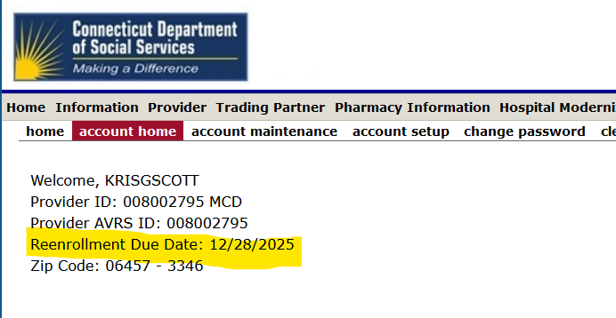
Gainwell Re-credentialing
While ABH still credentials provider agencies for the Mental Health Waiver, please remember that you must now re-credential with Gainwell every 2 years for billing purposes.

Slide 11
Electronic Visit Verification
Please make sure that you are changing client status from pending to active in Sandata. We are getting a number of calls from provider agency staff stating that there is not an authorization for client when the issue is that the client is still in pending status.
Please let ABH know if your agency is currently paying for any upsell services from Sandata, or would benefit from having an upsell service available so that information can be presented to DSS for possible additions.
RA Encounter notes will no longer be required once an Agency begins utilizing EVV and can demonstrate meeting RA Monthly note requirements. ABH will notify agencies when they can discontinue RA Encounter notes. If an agency has extended issues with not completing monthly notes the requirement for RA encounter notes may be re-instituted.

Slide 12
MHW renewal 4/1/2022
The Mental Health Waiver renewal was accepted by CMS and is now effective until 3/31/2027.
The following additions/changes were accepted:
The reserved capacity for Money Follows the Person was reduced from 60 to 45 per year.
Mental Health Counseling and Interpreter services were added to the MH Waiver. If your agency is interested in providing In-home MH Counseling, please contact Maria Michaud (Program Specialist) for an application.

Slide 13
MHW Advisory Council
Meets twice a year in April and October
Open to any MHW provider to send a representative
We encourage staff to identify MHW participants who might be interested in participating. Staff can bill for time spent with participant at meeting.

Slide 14
ABH Contact Information
Ann Marie Luongo, Program Manager (general waiver info, clinician info/issues, adding staff to ABH portal)
(860) 704-6211 aluongo@abhct.com
Jenny DeMars, Quality Assurance Supervisor (report cards, audits, notes)
(860) 704-6254 jdemars@abhct.com
Maria Michaud, Program Specialist (credentialing questions, RA trainings)
(860) 638-5341 mmichaud@abhct.com
Emilie LeBlanc, Claims Coordinator (authorization and claims issues, client eligibility)
860-704-6123 eleblanc@abhct.com
Chasaree Dow, Utilization Review Support (critical incident reports, client surveys, provider surveys, report cards)
(860) 704-6186 cdow@abht.com
NEW FAX NUMBER 860-920-4456

