Slide 1
Mental Health Waiver Provider Meeting
July 20, 2021

Slide 2
Agenda
Waiver Update
Average Enrolled by Month
Waiver Staffing changes
HCBS Rate Methodology Survey
Staffing Availability
RA Training Process
Phone visits
Utilization
Authorization Limits
Critical Incident reports/Connie notifications
Medicaid redeterminations/potential dis-enrollment
EVV
MHW Renewal
MHW Advisory Council

Slide 3
Waiver Update (as of 7/19/2021)
Active participants on the waiver: 592
Actively planning for admission to waiver (MHW & MFP): 35
Referrals pending disposition (MHW & MFP): 42
Waitlisted referrals for MHW community: 30
Community Census for Waiver Year 12: 615
Additional Slots for MFP participants Waiver Year 12: 60
If you are making a referral to the MHW please remember to send in any psychosocial and functional assessments to assist with eligibility determination.

Slide 5
Waiver Staffing Changes/Updates
Tamika Brock (DMHAS): out on leave. All of her cases have been reassigned back to previous clinicians
Melissa Stewart (ABH): last day was 7/14/21. Ann Marie will be conducting reviews with current clients and can be contacted for changes needed to plans and emergencies.
Amanda Smith (ABH): out on leave until 8/16/21. Please reach out to Katie Daly in the interim.
Nicole Kavalan (ABH): out on leave until 9/24/21. Please reach out to Katie Daly in the interim.
New DMHAS clinician (Jessica Branfield) to begin sometime in August.
Njaia Bryant (ABH) started as Claims Coordinator.

Slide 6
HCBS Rate Methodology Study
Data from the surveys has been collected and is being used to create a methodology for consistent rate reviews.
DSS is holding weekly meetings with the contractor. There is no timeline for the new rates at this time.

Slide 7
Staffing availability
MFP and MHW clinicians are continuing to assess and enroll participants onto the Mental Health Waiver.
Please keep ABH updated as to your ability to accept new referrals for CSP and RA services.
Please be honest about your ability to provide the services that are being requested.
Please alert us if one of your staff has tested positive for COVID-19 and which participants they may have had contact.
Please keep ABH updated of any contact/supervisor changes.

Slide 8
RA Training process
For Agency trainings:
Submit CBC and have potential staff take online pre-test before submitting training day roster to ABH for approval
Notify ABH when training has been completed and submit attendance roster.
ABH will notify agency when staff pass post-test.
For ABH trainings:
Submit CBC and have potential staff take online pre-test before requesting to register staff for upcoming trainings.
ABH will send an email to all registrants the afternoon before the training day with sign in information. ABH will alert agencies once staff have completed training and passed post-test.

Slide 9
Phone Visits
During the PHE, virtual visits are still allowed although in person visits are strongly encouraged except for cases of potential health hazards and client requests.
Virtual visits have been included in the new Mental Health Waiver which goes into effect April 1, 2022. They are meant to be used in times of a pandemic or severe weather conditions. Unscheduled virtual visits that occur due to weather or other natural disasters are acceptable, but any planned or ongoing virtual visits deemed necessary by client and/or staff need to be discussed and approved by clinicians.

Slide 10
Utilization
Service utilization numbers are low at this time.
Please remember to make clinicians aware of your ability to provide service during the pandemic.
If you are still utilizing telehealth to provide service, please ask for your authorization to be decreased accordingly.

Slide 11
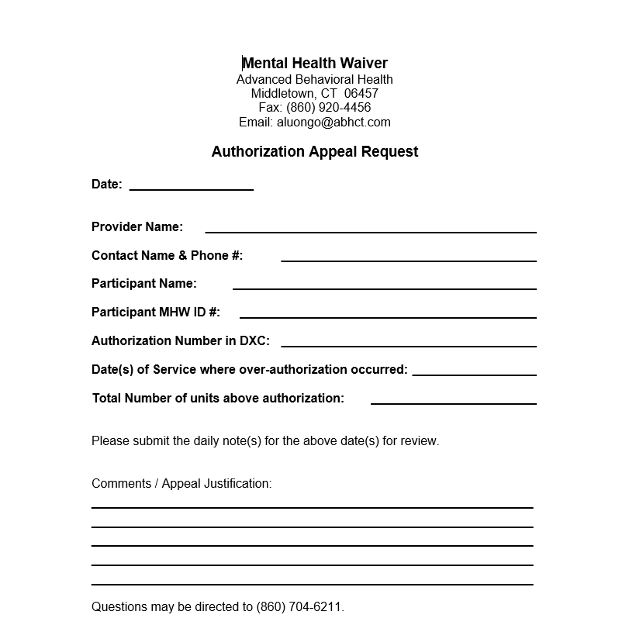
Authorization Limits
Please remember to track your authorizations.
Any increase in authorization must be pre-approved.
Any retroactive request for increased units must now be requested through ABH.

Slide 12
Critical Incident Reports/Connie
Please remember to submit Critical Incident Reports to ABH as needed. The form and training power point can be found on the ABH website.
CSP agencies will receive an email when one of their MHW clients enters the Emergency room or is admitted to the hospital. Please have your CSP staff follow up and provide a CI report for any ED visits or unplanned hospitalizations.

Slide 13
Medicaid Redeterminations/dis-enrollment
As DSS is beginning to clarify federal direction on how to dis-enroll clients during the Pandemic, please make sure staff are continuing to assist their participants in completing their redeterminations.
A number of individuals are expected to receive a Notice of Action stating their benefits are being discontinued effective 7/31/21. Please contact the MHW clinician immediately if one of your participants receives one of these notices.

Slide 14
Electronic Visit Verification
Use of EVV is now mandatory for visits on or after 7/1/21
Power points for the EVV trainings can be found on the ABH website.
If you are having issues with EVV, please send an email with the issue to the following addresses: ctevv@dxc.com, ctcustomercare@sandata.com, and aluongo@abhct.com.
RA Encounter notes will no longer be required once an Agency begins utilizing EVV and can demonstrate meeting RA Monthly note requirements. ABH will notify agencies when they can discontinue RA Encounter notes.

Slide 15
RA Monthly Notes
As EVV will be collecting some of the visit details, we are looking to eliminate the need to require RA Encounter notes.
As the EVV system does not collect all the data required, it will be very important that RA Monthly notes are completed fully and in a timely manner. Once an agency can demonstrate they are able to do this, ABH will no longer require the RA Encounter notes. This can be as early as 7/1/21 if all Monthly note requirements are met.
ABH will be providing further documents and guidance to Agencies on expectations of Monthly notes.

Slide 16
Staffing requirements with EVV
In order for ABH to collect utilization data, agencies will now be required to submit the last 5 digits of active staff social security numbers to ABH.
RA agencies will continue to complete criminal background checks on new staff and at least every 2 years thereafter.
CSP, Peer and SE agencies will now be required to complete criminal background checks on new staff and at least every 2 years thereafter.
ABH will be distributing current staffing rosters to agencies for verification.

Slide 17
MHW renewal 4/1/2022
The Mental Health Waiver is due for renewal 4/1/2022.
DMHAS is in the final stages of completing their revision of the Mental Health Waiver.
The following services are being requested as additions to the MHW:
Mental Health Counseling
Interpreter Services

Slide 18
MHW Advisory Council
Meets twice a year in April and October
Open to any MHW provider to send a representative
We encourage staff to identify MHW participants who might be interested in participating. Staff can bill for time spent with participant at meeting.

Slide 19
ABH Contact Information
Ann Marie Luongo, Program Manager
(860) 704-6211 aluongo@abhct.com
Lori-Lynn French, Quality Assurance Supervisor
(860) 704-6177 lfrench@abhct.com
Chastity Holloway, Program Specialist
(860) 638-5341 cholloway@abhct.com
Njaia Bryant, Claims Coordinator
(860) 704-6207 nbryant@abhct.com
Chasaree Dow, Utilization Review Support
(860) 704-6186 cdow@abht.com
NEW FAX NUMBER 860-920-4456

