Slide 1
Mental Health Waiver Provider Meeting
April 24, 2018

Slide 2
Agenda
Introductions: New Staff
Waiver Update
Community Support Program
Transitional Case Management
RA training updates
Transportation
Staff supervision requirements
Critical Incidents
Medicaid Coverage Issues
Notes/Documentation
Billing/ Audits
MHW Advisory Council

Slide 3
Waiver Update (as of 4/16/18)
601 Active clients on the waiver
52 Actively planning for admission to waiver (MHW & MFP)
115 Referrals pending disposition (MHW & MFP)
138 waitlisted referrals for MHW community
Community Census for Waiver Year10: 650
Additional Slots for MFP clients Waiver Year10: 60

Slide 4
Average Enrolled by Month

Slide 5
Community Support Program
Training/review held on April 12th
Please review handout if you did not attend and are a CSP provider
Additional trainings to be held on CSP Encounter/Monthly notes and Medicaid
Considering background checks and ongoing training requirements for CSP staff

Slide 6
Transitional Case Management
Pre-Enrollment
Services provided to persons residing in institutional settings prior to their transition to the waiver to prepare them for discharge …and to assist them with other aspects of the transition to community life by helping them gain access to needed waiver and other state plan services, as well as medical, social, housing, educational and other services and supports, regardless of the funding source for the services or supports to which access is gained
Maximum duration: Up to 180 days prior to transition
Maximum authorization: 25 hours prior to enrollment, at clinician’s discretion
After Enrollment
Transitional Case Management may also be provided to individuals following admission to the wavier during periods of brief institutionalization to prepare for return to the community and to assure continuity of care.
Maximum duration: Up to 90 days during enrollment
Maximum authorization: 25 hours during given episode , at clinician’s discretion

Slide 7
RA Training Updates
Recovery Assistants must now bring an active CT driver’s license (not state I.D.) when signing in for the one day training.
Please only send staff who can stay for the full day.
Agencies must have submitted a background check and results from on-line training before registering a RA for the one day training. Even though trainings are now being held in the auditorium and we have plenty of space, we still need to confirm eligibility prior to training day.
Mandatory Boundaries Training/6 hours per year
Reminder of RA requirements:
18 years of age
High School Diploma
Active Driver’s License

Slide 8
Transportation
Transportation is not a covered service by the Mental Health Waiver.
Because it is not reimbursed, providers cannot be required to provide transportation. It is at each agency’s discretion whether they provide transportation and what the parameters are.
Please do not promise a client transportation by another provider agency unless you have confirmed with that agency.
Clients should be utilizing med cabs, buses and other sources of transportation. Learning about these resources should be part of the recovery plan.

Slide 9
Staff supervision requirements
CSP/TCM:
Supervisor must be a licensed (licensed eligible) social worker, professional counselor, marriage and family therapist, or nurse.
Available for supervision and in crisis situations
Review notes completed by CSP staff
RA:
Supervisor must be a LCSW, LPC, LMFT or RN
Available for supervision and in crisis situations
Review notes completed by RA staff

Slide 10
Critical Incidents (CI)
A Critical Incident (CI) is defined as an incident that may have a real or potential serious impact on Waiver participants, staff, facilities, funded agencies, or the public or may bring about adverse publicity.
Examples of CI include but is not limited to: death; suicide attempt; threat; abuse/neglect/exploitation of client; missing persons; involvement of emergency services; criminal activity.
When in doubt? Submit one anyway!
Please submit written report to ABH within one business day of becoming aware of incident occurring
Fax to 860-920-4456 attn: Ann Marie Luongo

Slide 11
Medicaid Coverage issues
CSP must play active role in assisting client to maintain Husky C coverage
Per DSS, redetermination paperwork is now mailed 40 days in advance of expiration. Paperwork mailed in before system letter is generated will not be accepted. Recommendation is that paperwork be mailed within one week of receipt of letter to insure continued coverage.
DSS will only grant retroactive coverage up to 90 days from when the person loses coverage but only if he/she is still determined eligible

Slide 12
Sending in Redetermination Paperwork
Please make sure clients are submitting their DSS redetermination paperwork to the Scanning Center
DSS ConneCT Scanning Center
P. O Box 1320
Manchester, CT 06045-1320
Fax: 860-812-0022
www.connect.ct.gov
Clients can create online account, print new cover sheet, get forms, etc.

Slide 13
Monthly Progress Notes
Due by the 10th day of the following month
e.g., April notes due by May 10th
This means by the 10th, not the Monday following the 10th…
CSP notes include two sections, both required
Individual interventions
General summary
Monthly Note is required for any month where there is an open authorization

Slide 14
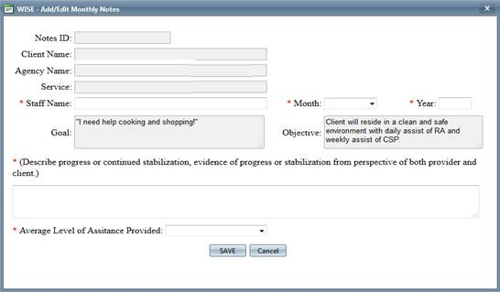
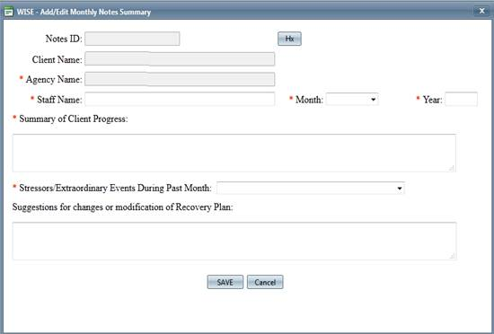
CSP Monthly Note
Step 1
Respond to each individual intervention
Step 2
Complete a general Monthly Notes Summary
For additional instruction, refer to WOS user guide on ABH website:
http://www.abhct.com/Customer-Content/WWW/CMS/files/Mental_Health_Waiver/ABH_WISE_Online_System_Manual-_PROVIDERS.pdf

Slide 15
Encounter Notes
Encounter notes must either be located in a client’s home or securely stored at the agency.
You must be able to supply notes for auditing purposes to ABH, DMHAS, DSS or CMS
Please make sure the supervisor is reviewing encounter notes for quality (both RA and CSP). Notes should contain all required elements and be using skill building language.

Slide 16
Updated Documentation Standards
Encounter note still required for each visit
Notes with missing information will be considered incomplete and will be recouped
Please make sure handwritten notes are legible!
A complete note includes the following information:
Client full name
Date of service
Staff full name
Service provided
LOA score
Goal
Comments
Time In
Time Out
Total Time
Staff signature
Client signature
Or, document if client refuses

Slide 17
Billing Reminders
Next three week cycle is June 15th
Check Run Schedule posted on ABH website
January 2018 – June 2018
CLEAN claims will be paid within a 30 day period from the date of submission
A claim is not considered “clean” when it requires further investigation prior to processing
Eligibility issues, insurance issues or the initial activation of a client onto the waiver may delay payment beyond the expected 30 day period

Slide 18
Billing – Rounding units
Most services are billed in quarter hour units
1 unit = 15 minutes
Service time is rounded up or down to the nearest 15 minute increment
EXAMPLES
1:00pm to 3:07pm = 2 hours 7 minutes
Round DOWN to 2 hours 0 minutes (8 units)
1:00pm to 3:08pm = 2 hours 8 minutes
Round UP to 2 hours 15 minutes (9 units)

Slide 19
Timely Filing
Please pay attention to the 60 day timely filing rule.
Given the numerous eligibility issues that come up with our clients, billing within the timely filing period allows us to hopefully rectify any issues before receiving payment is no longer possible.
LTSS eligibility needs to be back in place within 90 days or services cannot be paid retroactively.
Please notify ABH staff immediately if you become aware of any eligibility issues with your clients.
Notes:
Heidi late plan example

Slide 20
MHW Advisory Council
Meets twice a year in April and October
Open to any MHW provider to send a representative
We encourage staff to identify MHW clients who might be interested in participating. Staff can bill for time spent with client at meeting.

Slide 21
ABH Contact Information
Ann Marie Luongo, Program Manager
(860) 704-6211 aluongo@abhct.com
Vacant, Quality Assurance Supervisor
(860) 704-6213 @abhct.com
Monica Vaughn, Program Specialist
(860) 638-5341 mvaughn@abhct.com
Cathy Parente, Claims Coordinator
860-704-6201 cparente@abhct.com
Lori-Lynn French, Utilization Review Support
860-704-6177 lfrench@abhct.com
NEW FAX NUMBER 860-920-4456

